Slide 1
BIG DATA AND CLOUD PLATFORMS

Slide 2

whoami
Matteo Francia
Email: m.francia@unibo.it
Research fellow @ UniBO
Research topics
Big data / database
Geo-spatial analytics
Thesis proposals
https://big.csr.unibo.it/teaching/

Slide 3
Table of Contents and Exam
Handling data pipelines in the Cloud
Introduction to data platforms: shifting from databases to well-integrated data ecosystems
Definition of cloud and taxonomy of cloud services
Introduction to the most relevant Cloud Platforms
Introduction to the billing models that lay behind Cloud Computing services
Cluster migration: on-premises vs on-cloud
Real case studies on a cloud provider
Seminars by companies working with cloud and big data platforms
Consolidating data pipelines
Information systems, BI, data mining, machine learning
… all these points will be part of the oral examination! :)

Slide 4

Roadmap
Why going cloud?
From databases to data platforms
Managed services
Creating data pipelines in the cloud (in AWS)
Billing and cloud migration
Since we will cover several data needs, how familiar are you with the following tools/languages?
https://forms.gle/2DibVSdNgrgWTdVF6

Slide 5
Dictionary
Analysis is a detailed examination of something in order to understand its nature or determine its essential features.
Data analysis is the process of compiling, processing, and analyzing data so that you can use it to make decisions.
Analytics is the systematic analysis of data.
Data analytics is the specific analytical process being applied.
Big data is an industry term that has changed in recent years. Big data solutions are often part of data analysis solutions.
Curation is the action or process of selecting, organizing, and looking after the items in a collection. Data integrity is the maintenance and assurance of the accuracy and consistency of data over its entire lifecycle. Data veracity is the degree to which data is accurate, precise, and trusted.

Slide 6
Set up
You (will) have an AWS Educate account
A coupon of 150$ to test AWS cloud services
The content of these slides refers to this repo
https://github.com/w4bo/bigdata-aws/
Options
Work on your pc: check the `README.md` to install the necessary software tools
Mainly: git, IntelliJ IDEA (Community Edition), docker, AWS CLI, AWS SAM CLI
Download a pre-configured (VMware) VM with the installed software
Slides are available on "Virtuale"
https://aws.amazon.com/education/awseducate/

Slide 7
Set up
Download a pre-configured (VMware) VM with the installed software
Connect to a PC-lab using Guacamole (click here https://csi-rlab.campusfc.unibo.it/)
Enter your credentials
Choose `LabCEZ`
Click on the proper lab
Once logged in, download the VM from http://big.csr.unibo.it/downloads/ubuntu-64-bit.zip
Unzip the content and launch `VMware Workstation Pro` (from the desktop)
`File` > `Open...` > `path/to/the/unzipped/vm/*.vmx` file
Launch the VM (user: `bigdata`, pwd: `bigdata`)

Slide 8
So far
You have acquainted/practiced with on-premises solutions
You were given a working hardware cluster
... to deploy software applications on Hadoop-based stack
In the perspective of digital transformation¹, let us guess
How would you start from scratch?
How much time would it take?
¹ The process of using digital technologies to create new — or modify existing — business processes, culture, and customer experiences to meet changing business and market requirements

Slide 9
So far
No easy answers
Big-data (distributed) architectures require a lot of skills
Configuration: how do I set up dozens of new machines?
Networking: how do I cable dozens of machines?
Management: how do I replace a broken disk?
Upgrade: how do I extend the cluster with new services/machines?
(energy and cooling, software licenses, insurance...)
https://aws.amazon.com/compliance/data-center/data-centers/

Slide 10
So far
Technological perspective
How do we configure a distributed environment?
How do we set up/integrate/control independent services?
How do we orchestrate data flows?
Business perspective
Can we afford to spend resources on tasks that are not mission oriented?
No free lunch, each choice has cost/benefit
How much time does it take to master a technology?
How many people do I need?
… but first, which are our data needs?

Slide 11
So far
Can we afford to spend resources on tasks that are not mission oriented?
Mission: a statement used by a company to explain its purpose(s)

Slide 12
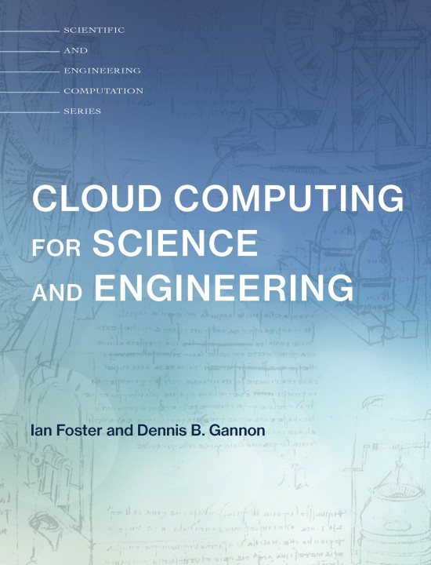
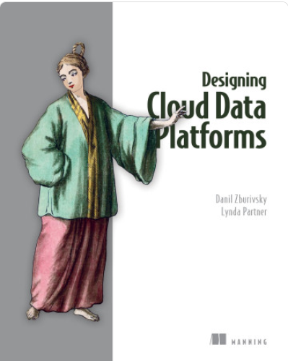
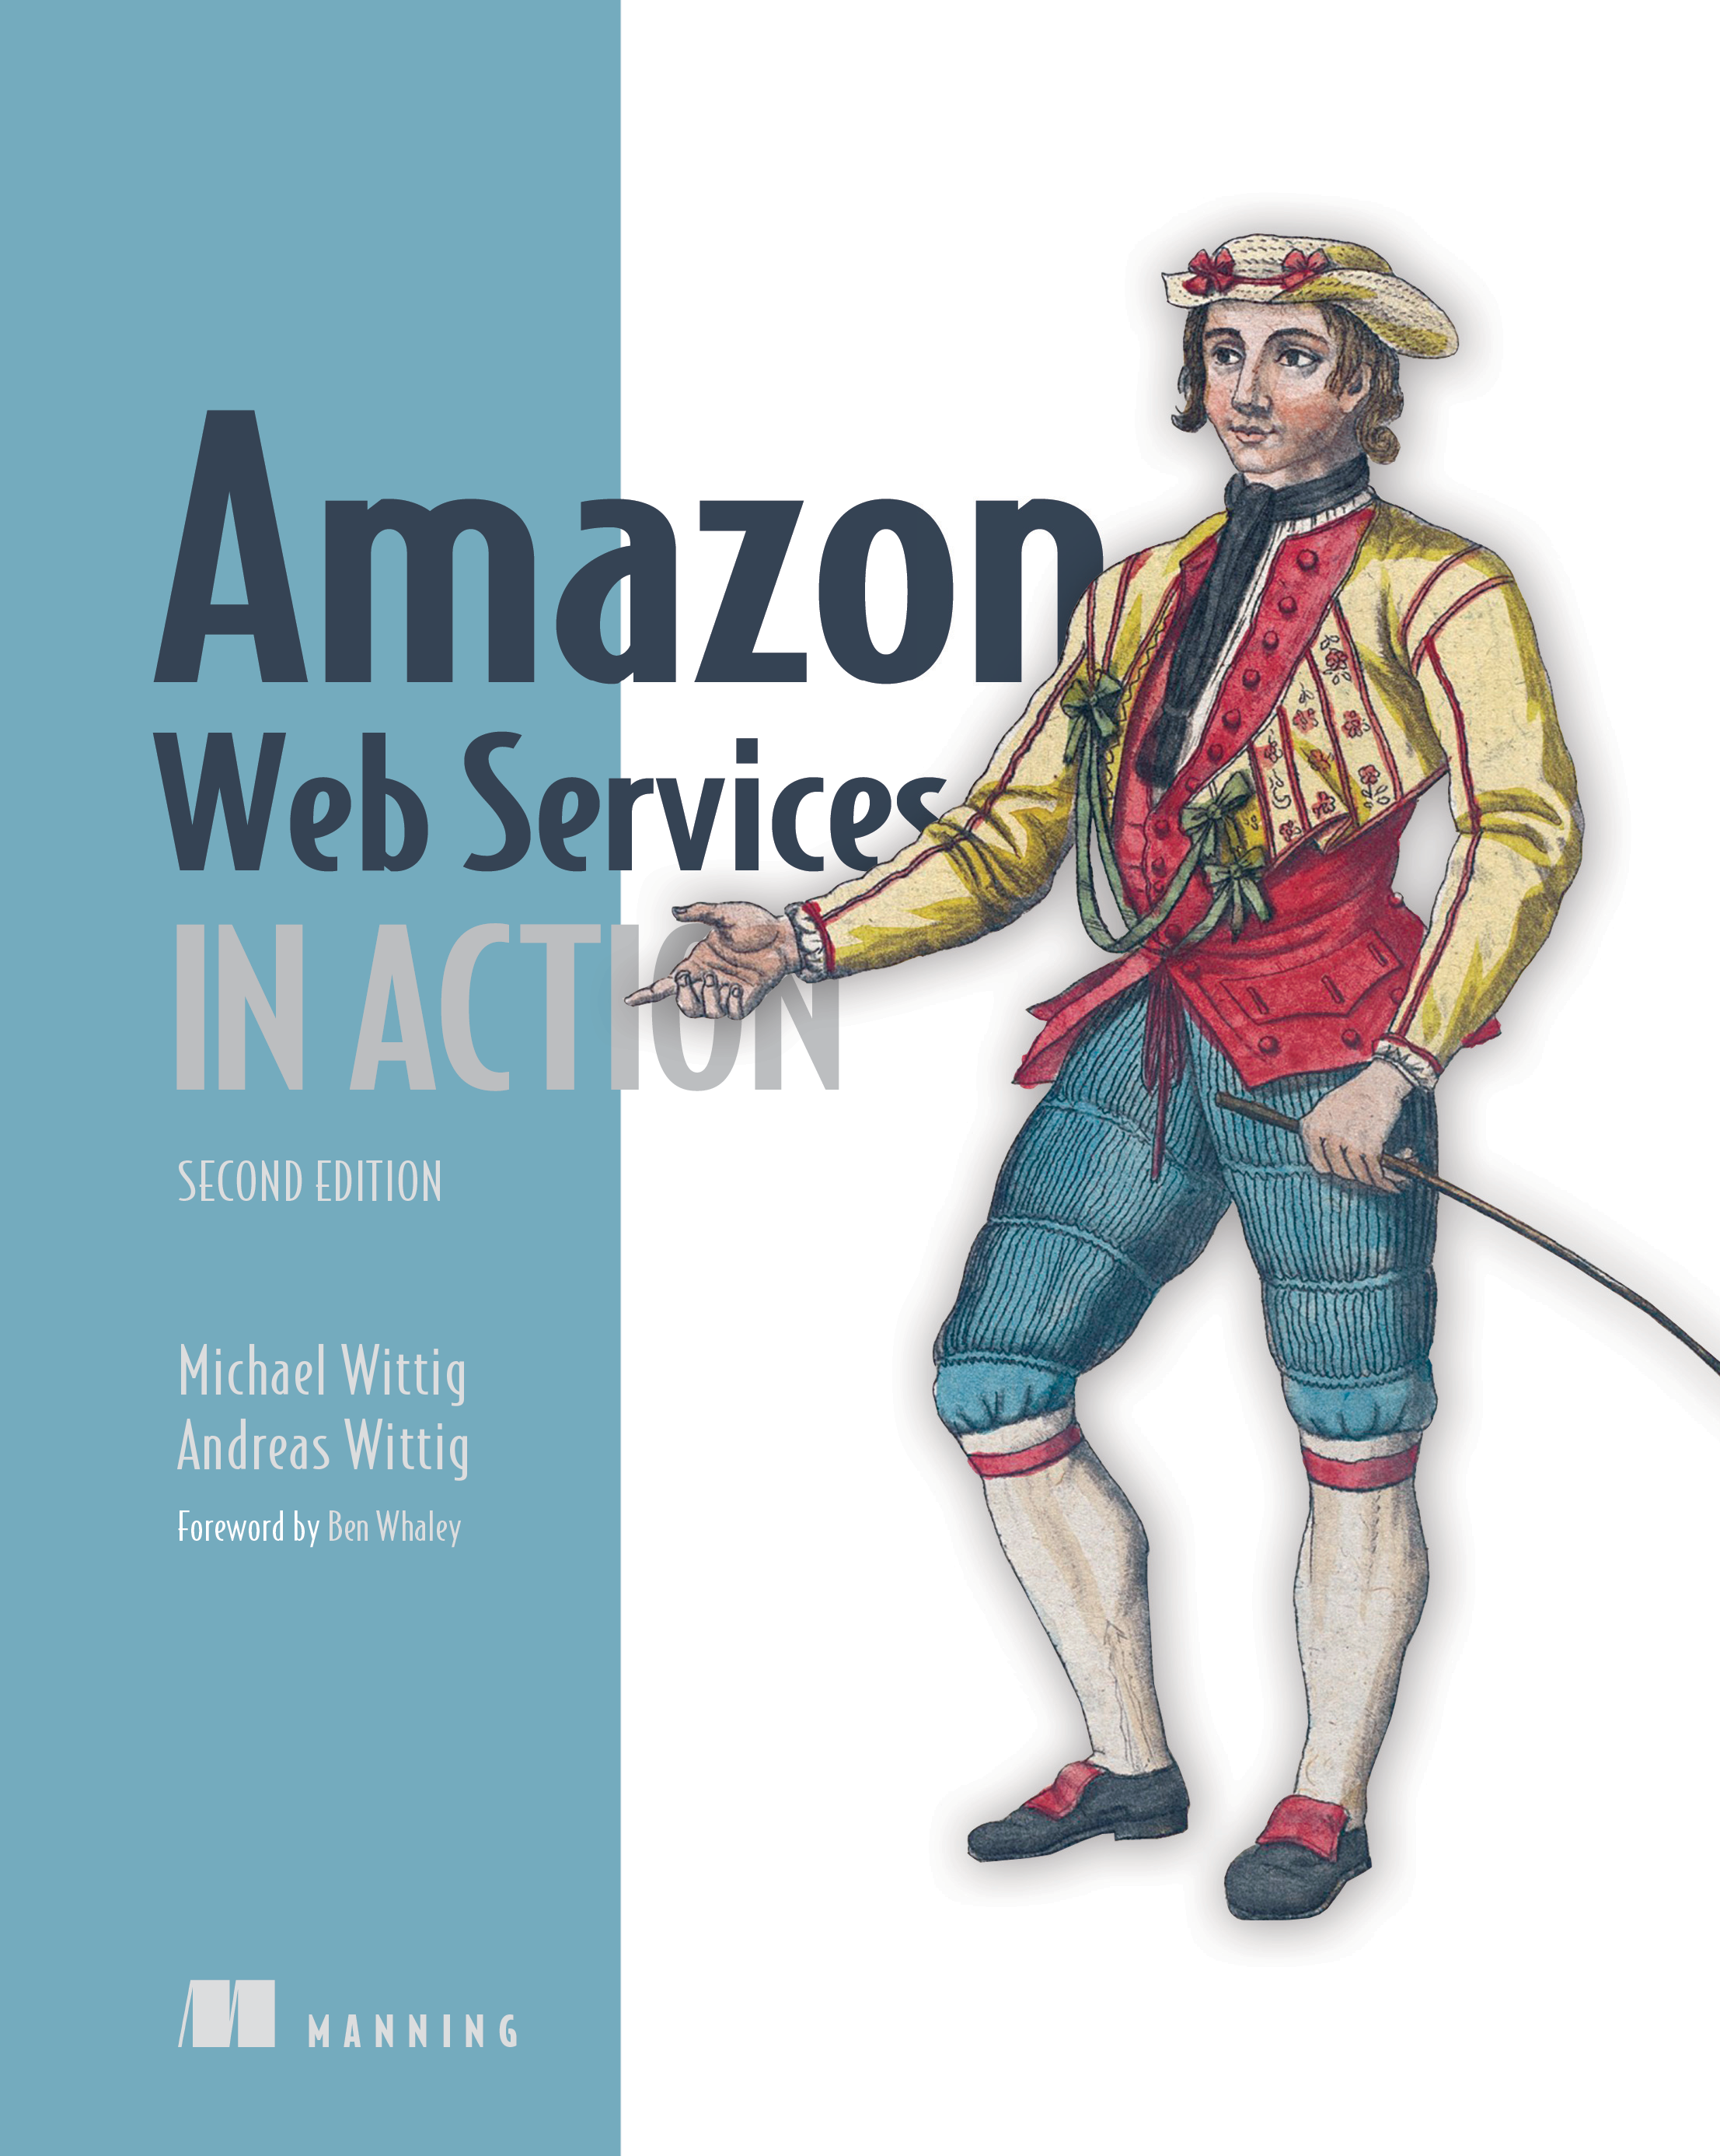


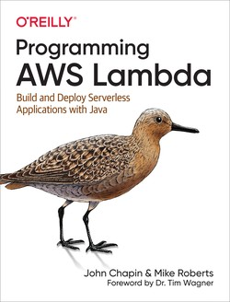
Teaching material
Books
Web content
Generic
Specific

Slide 13
BIG DATA AND CLOUD PLATFORMS
From databases to data platforms

Slide 14
How did we get here?
Data-Driven Innovation
Use of data and analytics to foster new products, processes and markets
Drive discovery and execution of innovation, achieving new services with a business value
Analytics
A catch-all term for different business intelligence (BI)- and application-related initiatives
E.g., of analyzing information from a particular domain
E.g., applying BI capabilities to a specific content area (e.g., sales, service, supply chain)
Advanced Analytics
(Semi-)Autonomous examination of data to discover deeper insights, make predictions, or generate recommendations (e.g., through data/text mining and machine learning)
Augmented Analytics
Use of technologies such as machine learning and AI to assist with data preparation, insight generation and insight explanation to augment how people explore and analyze data
https://www.gartner.com/en/information-technology/glossary (accessed 2022-08-01)

Slide 15
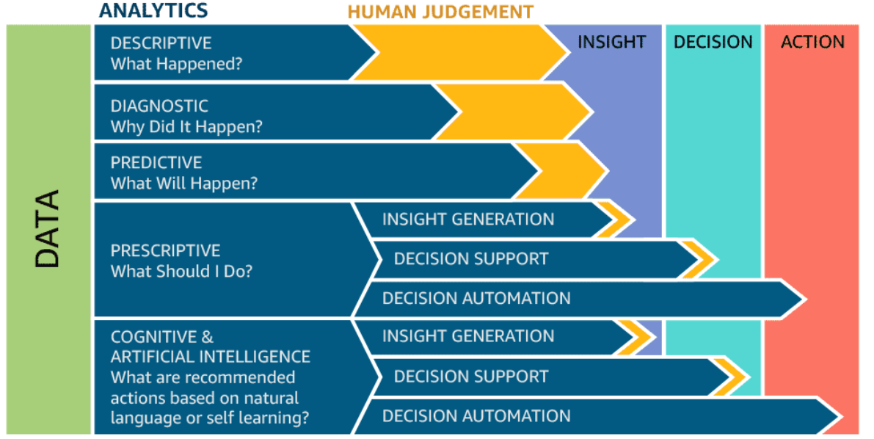
How did we get here?

Slide 16
Data platform
Companies are collecting tons of data to enable advanced analytics
Raw data is difficult to obtain, interpret, and maintain
Data is more and more heterogeneous
There is need for curating data to make it consumable
Where are we collecting/processing data?
Getting value from data is not (only) a matter of storage
Need integrated and multilevel analytical skills and techniques

Slide 17
Data platform
Getting value from data is not (only) a matter of storage
Any example?
“It is a capital mistake to theorize before one has data. Insensibly, one begins to twist the facts to suit theories, instead of theories to suit facts.”
– Sherlock Holmes

Slide 18
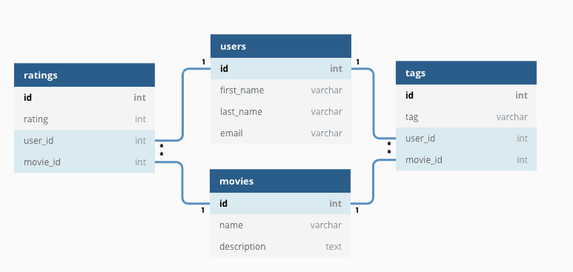
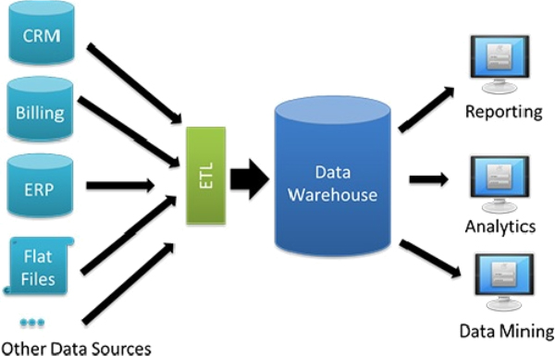
Data platform
Database
"A database is a structured and persistent collection of information about some aspect of the real world organized and stored in a way that facilitates efficient retrieval and modification. The structure of a database is determined by an abstract data model. Primarily, it is this structure that differentiates a database from a data file."
Data Warehouse
"A collection of data that supports decision-making processes. It provides the following features: subject-oriented, integrated and consistent, not volatile."
Özsu M.T. (2018) Database. In: Encyclopedia of Database Systems. Springer, New York, NY. https://doi.org/10.1007/978-1-4614-8265-9_80734 Matteo Golfarelli and Stefano Rizzi. Data warehouse design: Modern principles and methodologies. McGraw-Hill, Inc., 2009.

Slide 19

Data platform: OLTP vs OLAP

Slide 20
Data platform: OLTP vs OLAP
Characteristic | OLTP | OLAP
Nature | Constant transactions (queries/updates) | Periodic large updates, complex queries
Examples | Accounting database, online retail transactions | Reporting, decision support
Type | Operational data | Consolidated data
Data retention | Short-term (2-6 months) | Long-term (2-5 years)
Storage | Gigabytes (GB) | Terabytes (TB) / Petabytes (PB)
Users | Many | Few
Protection | Robust, constant data protection and fault tolerance | Periodic protection

Slide 21
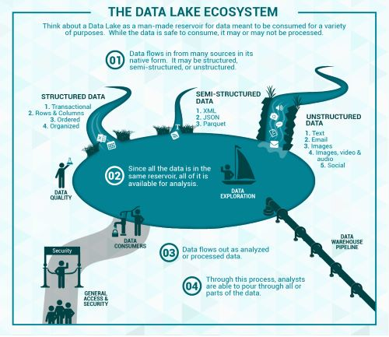
Data platform
Data lake
Couto et al.: “A DL is a central repository system for storage, processing, and analysis of raw data, in which the data is kept in its original format and is processed to be queried only when needed. It can store a varied amount of formats in big data ecosystems, from unstructured, semi-structured, to structured data sources”
Couto, Julia, et al. "A Mapping Study about Data Lakes: An Improved Definition and Possible Architectures." SEKE. 2019. https://dunnsolutions.com/business-analytics/big-data-analytics/data-lake-consulting

Slide 22
Data platform: DWH vs Data Lake

Slide 23
Data platform: DWH vs Data Lake
Characteristics | Data warehouse | Data lake
Data | Relational | Non-relational and relational
Schema | Designed prior to implementation (schema-on-write) | Written at the time of analysis (schema-on-read)
Price/ performance | Fastest query results using higher cost storage | Query results getting faster using low-cost storage
Data quality | Highly curated data that serves as the central version of the truth | Any data, which may or may not be curated (e.g., raw data)
Users | Business analysts | Data scientists, data developers, and business analysts (using curated data)
Analytics | Batch reporting, BI, and visualizations | Machine learning, predictive analytics, data discovery, and profiling.

Slide 24
Data platform
Data lakes have increasingly taken the role of data hubs
Eliminate up-front costs of ingestion and ETL since data are stored in original format
Once in DL, data are available for analysis by everyone in the organization
Drawing a sharp line been storage/computation/analysis is hard
Is a database just storage?
What about SQL/OLAP?
Blurring of the architectural borderlines
DL is often replaced by “data platform” or “data ecosystem”
Encompass systems supporting data-intensive storage, computation, analysis

Slide 25
Data platform
Data platform
An integrated set of technologies that collectively meets an organization’s end-to-end data needs such as acquisition, storage, preparation, delivery, and governance, as well as a security layer for users and applications
Rationale: relieve users from complexity of administration and provision
Not only technological skills, but also privacy, access control, etc.
Users should only focus on functional aspects
Are we done? No!
Lacking smart support to govern the complexity of data and transformations
Data transformations must be governed to prevent DP turning into a swamp
Amplified in data science, with data scientists prevailing data architects
Leverage descriptive metadata and maintenance to keep control over data

Slide 26
Data platform: Data management

Slide 27
Data provenance
Provenance (also referred to as lineage, pedigree, parentage, genealogy)
The description of the origins of data and the process by which it arrived at the database
Not only data products (e.g., tables, files), but also the processes that created them
Use cases
Scientific/research domain. Data used in the scientific field can be ad hoc and driven by individual researchers or small communities. The scientific field is moving towards more collaborative research and organizational boundaries are disappearing. Sharing data and metadata across organizations is essential, leading to a convergence on common schemes to ensure compatibility. Issues of trust, quality, and copyright of data are significant when using third-party data in such a loosely connected network.
Business domain. Users traditionally work with an organized data schema, where the structure and semantics of the data in use is shared across the corporation or even B2B. Yet, a large proportion of businesses deal with bad quality data. Sources of bad data need to be identified and corrected to avoid costly errors in business forecasting.
Simmhan, Yogesh L., Beth Plale, and Dennis Gannon. "A survey of data provenance techniques." Computer Science Department, Indiana University, Bloomington IN 47405 (2005): 69.

Slide 28

Data provenance
Astronomers are creating an international Virtual Observatory
A federation of all the world significant astronomical data resources coupled with provision of the computational resources needed to exploit the data scientifically
Astronomy changed from being an individualistic to a collective enterprise
Telescope time is devoted/allocated to systematic sky surveys and analysis is performed using data from the archives
Astronomers are increasingly relying on data that they did not take themselves
Raw data bear many instrumental signatures that must be removed in the process of generating data products
Mann, Bob. "Some data derivation and provenance issues in astronomy." Workshop on Data Derivation and Provenance, Chicago. 2002. https://www.esa.int/Science_Exploration/Space_Science/Webb/Webb_inspects_the_heart_of_the_Phantom_Galaxy (accessed 2022-08-01)

Slide 29
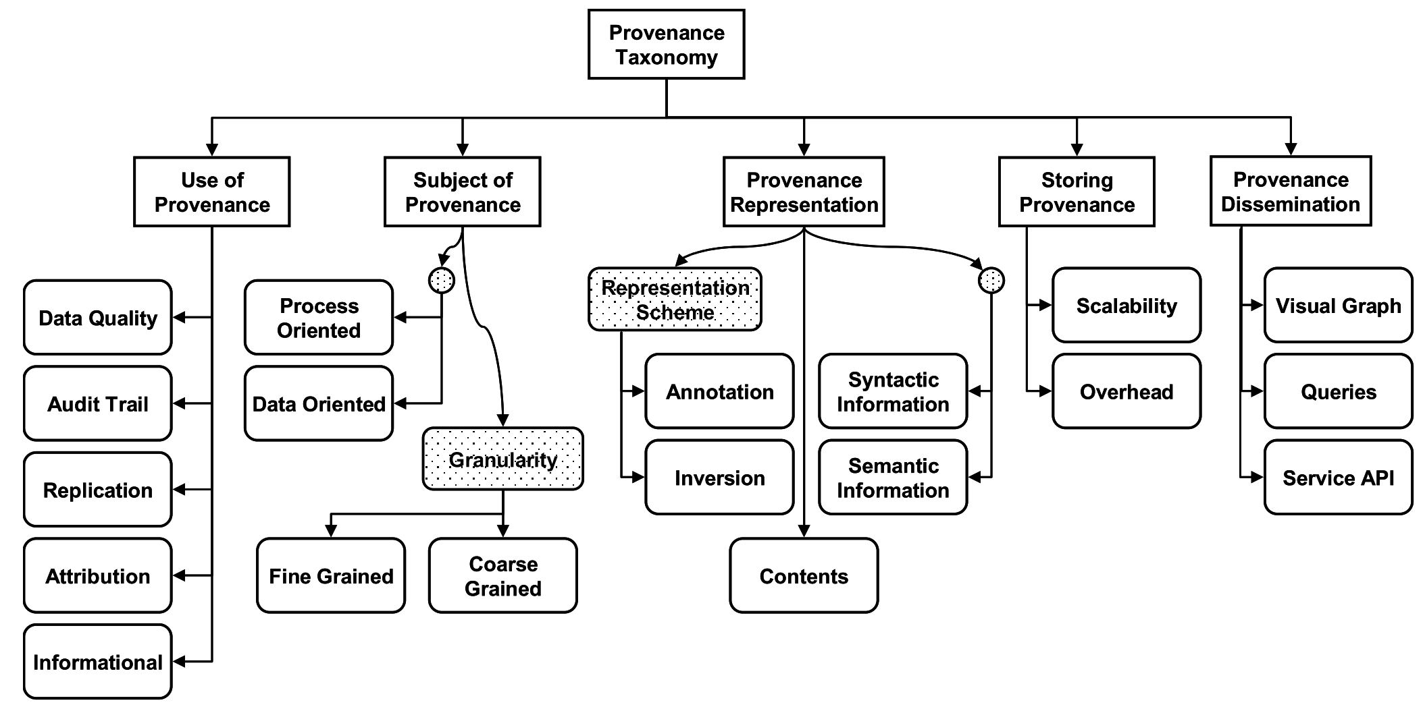
Data provenance
Simmhan, Yogesh L., Beth Plale, and Dennis Gannon. "A survey of data provenance techniques." Computer Science Department, Indiana University, Bloomington IN 47405 (2005): 69.

Slide 30
Data provenance
Granularity
Fine-grained (instance level): tracking data items (e.g., a tuple in a dataset) transformations
Coarse-grained (schema-level): tracking dataset transformations
Queries
Where provenance: given some output, which inputs did the output come from?
How provenance: given some output, how were the inputs manipulated?
Why provenance: given some output, why was data generated?
E.g., in the form of a proof tree that locates source data items contributing to its creation
Simmhan, Yogesh L., Beth Plale, and Dennis Gannon. "A survey of data provenance techniques." Computer Science Department, Indiana University, Bloomington IN 47405 (2005): 69. Ikeda, Robert, and Jennifer Widom. Data lineage: A survey. Stanford InfoLab, 2009.

Slide 31
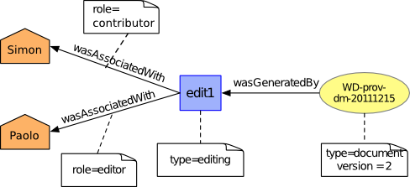
Data provenance
Data provenance, an example of data management
Metadata pertaining to the history of a data item
Pipeline including the origin of objects and operations they are subjected to
We have a standard: https://www.w3.org/TR/prov-dm/
https://www.w3.org/TR/prov-dm/

Slide 32
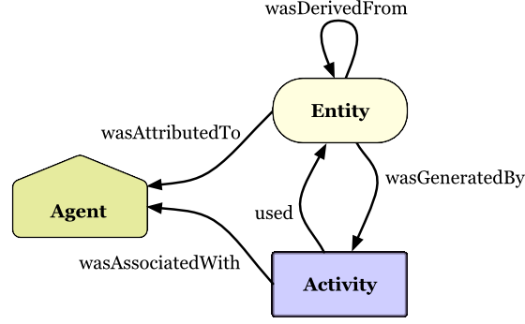
Data provenance
Entity
Physical/conceptual things
Activity
Dynamic aspects of the world, such as actions
How entities come into existence, often making use of previously existing entities
Agent
A person, a piece of software
Takes a role in an activity such that the agent can be assigned some degree of responsibility for the activity taking place
https://www.w3.org/TR/2013/NOTE-prov-primer-20130430/

Slide 33
Data provenance
Use cases for data provenance
Accountability and auditing
Data quality
Monitoring of the quality (e.g., accuracy) of the objects produced
Notify when a transformation pipeline is not behaving as expected
Debugging
Inferring the cause of pipeline failures is challenging
Store inputs of each operation with versions and environmental settings (RAM, CPUs, etc.)
And so on...

Slide 34
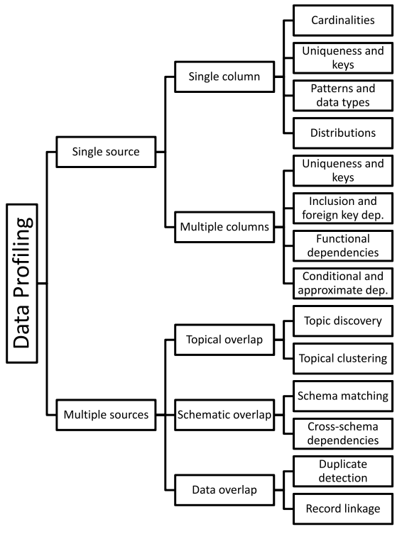
Data profiling
Data profiling
A broad range of methods to efficiently analyze a given data set
E.g., in a relational scenario, tables of a relational database are scanned to derive metadata, such as data types and value patterns, completeness and uniqueness of columns, keys and foreign keys, and occasionally functional dependencies and association rules
Naumann, Felix. "Data profiling revisited." ACM SIGMOD Record 42.4 (2014): 40-49.

Slide 35
Data profiling
Use cases
Query optimization
Performed by DBMS to support query optimization with statistics about tables and columns
Profiling results can be used to estimate the selectivity of operators and the cost of a query plan
Data cleansing (typical use case is profiling data)
Prepare a data cleansing process by revealing data errors (e.g., inconsistent formatting), missing values or outliers
Data integration and analytics
Challenges?
Naumann, Felix. "Data profiling revisited." ACM SIGMOD Record 42.4 (2014): 40-49.

Slide 36
Data profiling
Challenges
The results of data profiling are computationally complex to discover
E.g., discovering keys/dependencies usually involves some sorting step for each considered column
Verification of complex constraints on column combinations in a database
What is the complexity of this task?
Memory, profiling is often performed on data sets that may not fit into main memory
Naumann, Felix. "Data profiling revisited." ACM SIGMOD Record 42.4 (2014): 40-49.

Slide 37

Data versioning
Version control
A class of systems responsible for managing changes to computer programs, documents, or data collections
Changes are identified by a number/letter code, termed the revision/version number
However, data pipelines is not only about code bult also about
Model Version control
Data Version Control
Model Parameter Tracking
Model Performance Comparison

Slide 38
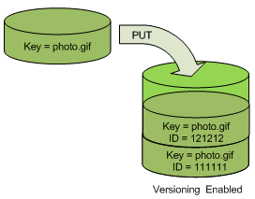
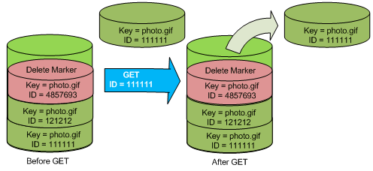
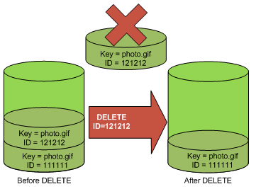
Data versioning
Support CRUD (Create, Read, Update, Delete) operations with versions
E.g., on AWS (PUT, GET, DELETE), what about update?
https://docs.aws.amazon.com/AmazonS3/latest/userguide/versioning-workflows.html (accessed 2022-08-01)

Slide 39

In action
Lab: California housing prices

Slide 40
Data platform
Are we done? No!
Metadata can become bigger than data themselves
We need meta meta-data (or models)...
... chasing our own tails
Data management is still a (research) issue in data platforms

Slide 41
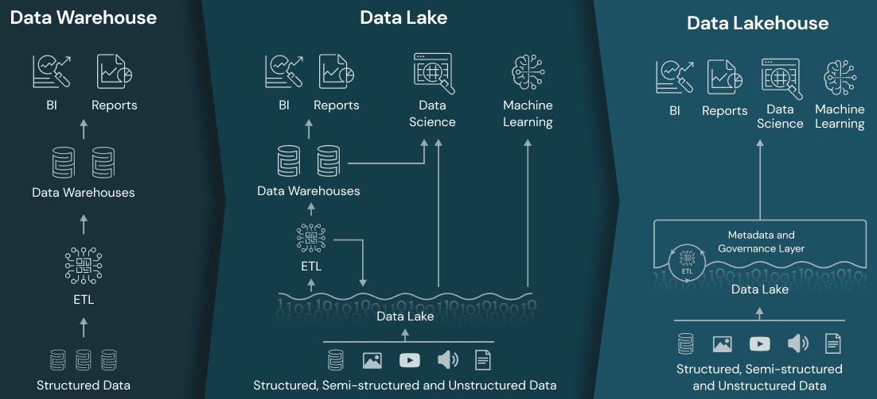
Data lakehouse

Slide 42
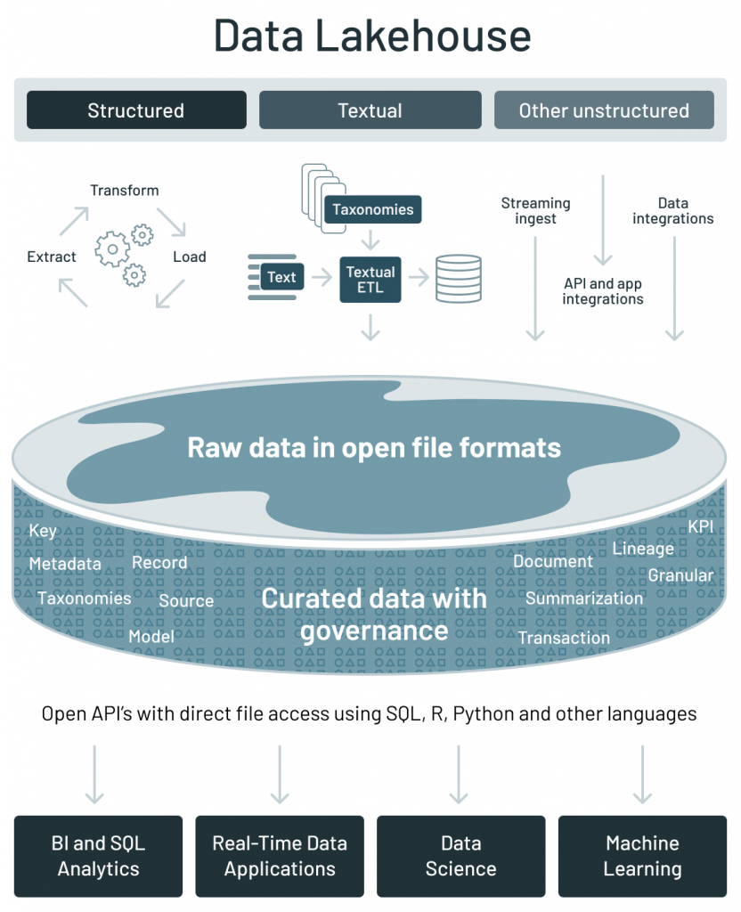
Data lakehouse
 | Data warehouse | Data lake | Data lakehouse
Data format | Closed, proprietary format | Open format (e.g., Parquet) | Open format
Types of data | Structured data, with limited support for semi-structured data | All types: Structured data, semi-structured data, textual data, unstructured (raw) data | All types: Structured data, semi-structured data, textual data, unstructured (raw) data
Data access | SQL-only, no direct access to file | Open APIs for direct access to files with SQL, R, Python and other languages | Open APIs for direct access to files with SQL, R, Python and other languages
Reliability | High quality, reliable data with ACID transactions | Low quality, data swamp | High quality, reliable data with ACID transactions
Governance and security | Fine-grained security and governance for row/columnar level for tables | Poor governance as security needs to be applied to files | Fine-grained security and governance for row/columnar level for tables
Performance | High | Low | High
Scalability | Scaling becomes exponentially more expensive | Scales to hold any amount of data at low cost, regardless of type | Scales to hold any amount of data at low cost, regardless of type
Use case support | Limited to BI, SQL applications and decision support | Limited to machine learning | One data architecture for BI, SQL and machine learning
Key technologies used to implement open source Data Lakehouses
Databricks’ Delta Lake
Apache Hudi
Apache Iceberg
https://databricks.com/blog/2021/05/19/evolution-to-the-data-lakehouse.html

Slide 43
Data fabric
Data fabric enables frictionless access and sharing of data in a distributed data environment
It enables a single and consistent data management framework, which allows seamless data access and processing by design across otherwise siloed storage
Leverages both human and machine capabilities to access data in place or support its consolidation where appropriate
Continuously identifies and connects data from disparate applications to discover unique, business-relevant relationships between the available data points
It is a unified architecture with an integrated set of technologies and services
Designed to deliver integrated and enriched data – at the right time, in the right method, and to the right data consumer – in support of both operational and analytical workloads
Combines key data management technologies – such as data catalog, data governance, data integration, data pipelining, and data orchestration
Gartner, 2019 https://www.gartner.com/en/newsroom/press-releases/2019-02-18-gartner-identifies-top-10-data-and-analytics-technolo Gartner, 2021 https://www.gartner.com/smarterwithgartner/data-fabric-architecture-is-key-to-modernizing-data-management-and-integration K2View Whitepaper: What is a Data Fabric? The Complete Guide, 2021

Slide 44
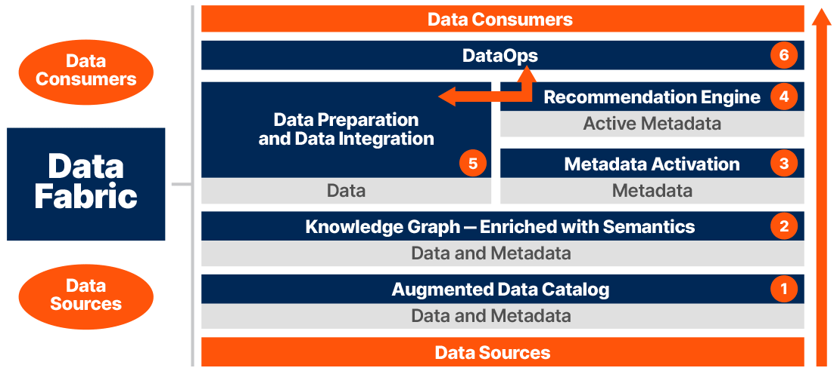
Data fabric
https://www.irion-edm.com/data-management-insights/gartner-data-summit-irion-representative-vendor-for-data-fabric-technology/

Slide 45
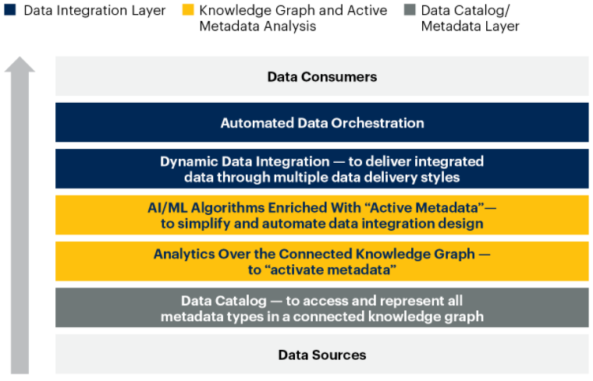
Data fabric
Gartner, 2021 https://www.gartner.com/smarterwithgartner/data-fabric-architecture-is-key-to-modernizing-data-management-and-integration

Slide 46
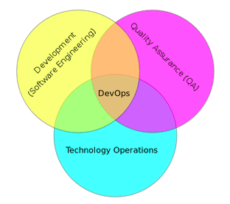
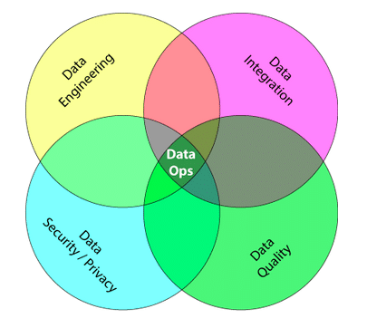
DataOps
From DevOps to DataOps
“A collaborative data management practice focused on improving the communication, integration and automation of data flows between data managers and data consumers across an organization”
Data analytics improved in terms of velocity, quality, predictability and scale of software engineering and deployment
Some key rules
Establish progress and performance measurements at every stage
Automate as many stages of the data flow as possible
Establish governance discipline (governance-as-code)
Design process for growth and extensibility
Gartner, 2020 https://www.gartner.com/smarterwithgartner/how-dataops-amplifies-data-and-analytics-business-value Andy Palmer, 2015 https://www.tamr.com/blog/from-devops-to-dataops-by-andy-palmer/ William Vorhies, 2017 https://www.datasciencecentral.com/profiles/blogs/dataops-it-s-a-secret

Slide 47
Data mesh
Distributed data architecture, under centralized governance and standardization for interoperability, enabled by a shared and harmonized self-serve data infrastructure
Domain-oriented decentralized data ownership
Decentralization and distribution of responsibility to people who are closest to the data, in order to support continuous change and scalability
Each domain exposes its own op/analytical APIs
Data as a product (quantum)
Products must be discoverable, addressable, trustworthy, self-describing, secure
Self-serve data infrastructure as a platform
High-level abstraction of infrastructure to provision and manage the lifecycle of data products
Federated computational governance
A governance model that embraces decentralization and domain self-sovereignty, interoperability through global standardization, a dynamic topology, automated execution of decisions by the platform
Zhamak Dehghani, 2019 https://martinfowler.com/articles/data-monolith-to-mesh.html Zhamak Dehghani, 2020 https://martinfowler.com/articles/data-mesh-principles.html
Notes:
https://www.youtube.com/watch?v=_bmYXWCxF_Q

Slide 48
Data mesh vs data fabric
A data fabric and a data mesh both provide an architectural framework to access data across multiple technologies and platforms
Data fabric
Attempts to centralize and coordinate data management
Tackles the complexity of data and metadata in a smart way that works well together
Data mesh
Emphasis on decentralization and data domain autonomy
Focuses on organizational change; it is more about people and process
They are design concepts, not things
They are not mutually exclusive
They are architectural frameworks, not architectures
The frameworks must be adapted and customized to your needs, data, processes, and terminology
Gartner estimates 25% of data management vendors will provide a complete data fabric solution by 2024 – up from 5% today
Alex Woodie, 2021 https://www.datanami.com/2021/10/25/data-mesh-vs-data-fabric-understanding-the-differences/ Dave Wells, 2021 https://www.eckerson.com/articles/data-architecture-complex-vs-complicated

Slide 49
Example of data platform: Hadoop-based
A data platform on the Hadoop stack requires several tools
How many levels of complexity are hidden here?
How do you provision it?
Manual provisioning on-premises
Semi-automatic provisioning on-premises
Automatic provisioning in the cloud
Storage .
Resources .
Application .
GUI .
Messaging .
Orchestration .
Hue
Pig
Hive
Phoenix
Map Reduce
Batch
Spark
in mem
Flink
real-time
Others…
Impala
MPP
Kafka
Airflow
Zookeeper
HBASE
NoSQL
YARN
HDFS
NoSQL

Slide 50
On-premises manual provisioning
Hardly advisable, if not for small and local tests
Technical challenges
Installation: how do I set up a new machine?
Networking: how do I cable dozens of machines?
Management: how do I replace a broken disk?
Upgrade: how do I extend the cluster with new services/machines?
(energy and cooling, software licenses, insurance...)
Technological challenges
How do we configure a distributed environment?
How do we set up/integrate/control independent services?
How do we orchestrate data flows?
Business challenges
Can we afford to spend resources on tasks that are not mission oriented?
No free lunch, each choice has cost/benefit
How much time does it take to master a technology?
How many people do I need?

Slide 51










Example of data platform: MOSES
Example of a data platform (MOSES)
Functional architecture
Components of MOSES are in orange
Others are standard components in charge of producing/consuming, processing, storing, and visualizing data
The orchestrator (e.g., Oozie) manages (e.g., schedules) the data transformation processes
Orchestrator
Data Processes
MOSES
Proc. 1
Proc. 2
…
Proc. m
Metadata Extractor
Metadata Search
Engine
Provenance Manager
Storage
Trigger Engine
Other Storages
DFS
Custom components
Metadata
Process Interfaces
MOSES Interfaces
Web Interface
Other Interfaces
Workflow Administration
Metadata GUI
Francia, M., Gallinucci, E., Golfarelli, M., Rizzi, S. et al. (2021). Making data platforms smarter with MOSES. Future Generation Computer Systems, 125, 299-313.

Slide 52
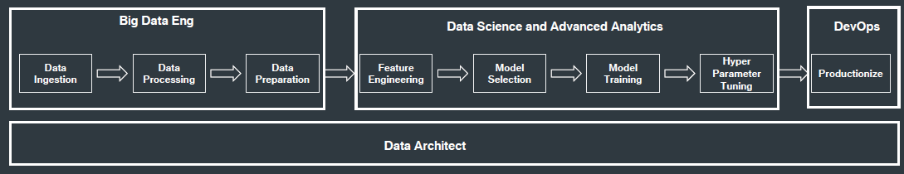
Data platform

Slide 53
Data platform: related job positions
Data platform engineer
Orchestrate the successful implementation of cloud technologies within the data infrastructure of their business
Solid understanding of impact database types and implementation
Responsible for purchasing decisions for cloud services and approval of data architectures
Data analyst
Analyze data systems, creating automated systems for retrieving data from the data platform
Cloud data analysts are more commonly members of the business user population
Data scientist
Analyze and interpret complex digital data
Work with new technologies (e.g., machine learning) to deepen the business' understanding and gain new insights
Data architect
Team members who understand all aspects of a data platform's architecture
Work closely with the data platform engineers to create data workflows
Responsible for designing and testing new database architectures and planning both data and architecture migrations
Data pipeline engineer
Responsible for planning, architecting, and building large-scale data processing systems

Slide 54
Data platform
MOSES is used within a DP that builds atop the Hadoop ecosystem
The cluster runs the Cloudera Distribution for Apache Hadoop 6.2.0 and Docker
The metadata collected and manipulated are stored in a graph database
The graph data model favors the modeling of highly interconnected data in the absence of fixed schemas
Service decoupling: functional components are accessible using RESTful APIs
Orchestrator
Data Processes
MOSES
Proc. 1
Proc. 2
…
Proc. m
Metadata Extractor
Metadata Search
Engine
Provenance Manager
Storage
Trigger Engine
Other Storages
DFS
Custom components
Metadata
Process Interfaces
MOSES Interfaces
Web Interface
Other Interfaces
Workflow Administration
Metadata GUI
Leoni Anna Giulia. "Gestione di un data lake strutturato attraverso il riconoscimento semantico dei dati acquisiti."

Slide 55
BIG DATA AND CLOUD PLATFORMS
Cloud computing

Slide 56
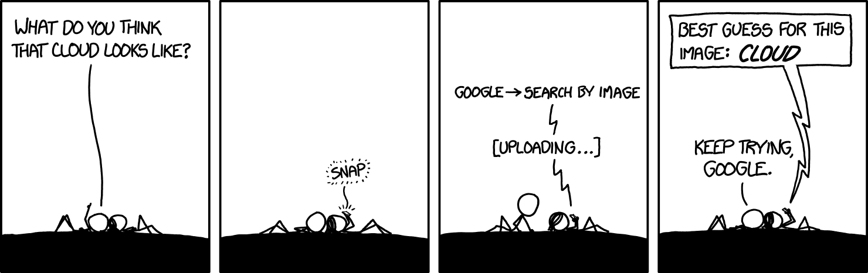
https://xkcd.com/1444/

Slide 57
Why going cloud?
Cloud computing (National Institute of Standards and Technology)
“A model for enabling ubiquitous, convenient, on-demand network access to a shared pool of configurable computing resources (e.g., networks, servers, storage, services) that can be rapidly provisioned and released with minimal management effort or service provider interaction.”
On-demand self-service (consume services when you want)
Broad network access (consume services from anywhere)
Resource pooling (infrastructure, virtual platforms, and applications)
Rapid elasticity (enable horizontal scalability)
Measured service (pay for the service you consume as you consume)
Digital transformation involves the cloud to create/change business flows
Often involves changing the company culture to adapt to this new way of doing business
One of the end goal is to meet ever-changing business and market demand

Slide 58
Why going cloud?
Goal: adjusts capacity to have predictable performance at the lowest cost
Scalability that is not possible on premises
Scale from one to thousands of servers
Elasticity
Automatically scale resources in response to run-time conditions
Adapt to changes in workload by turning on/off resources to match the necessary capacity
Core justification for the cloud adoption

Slide 59
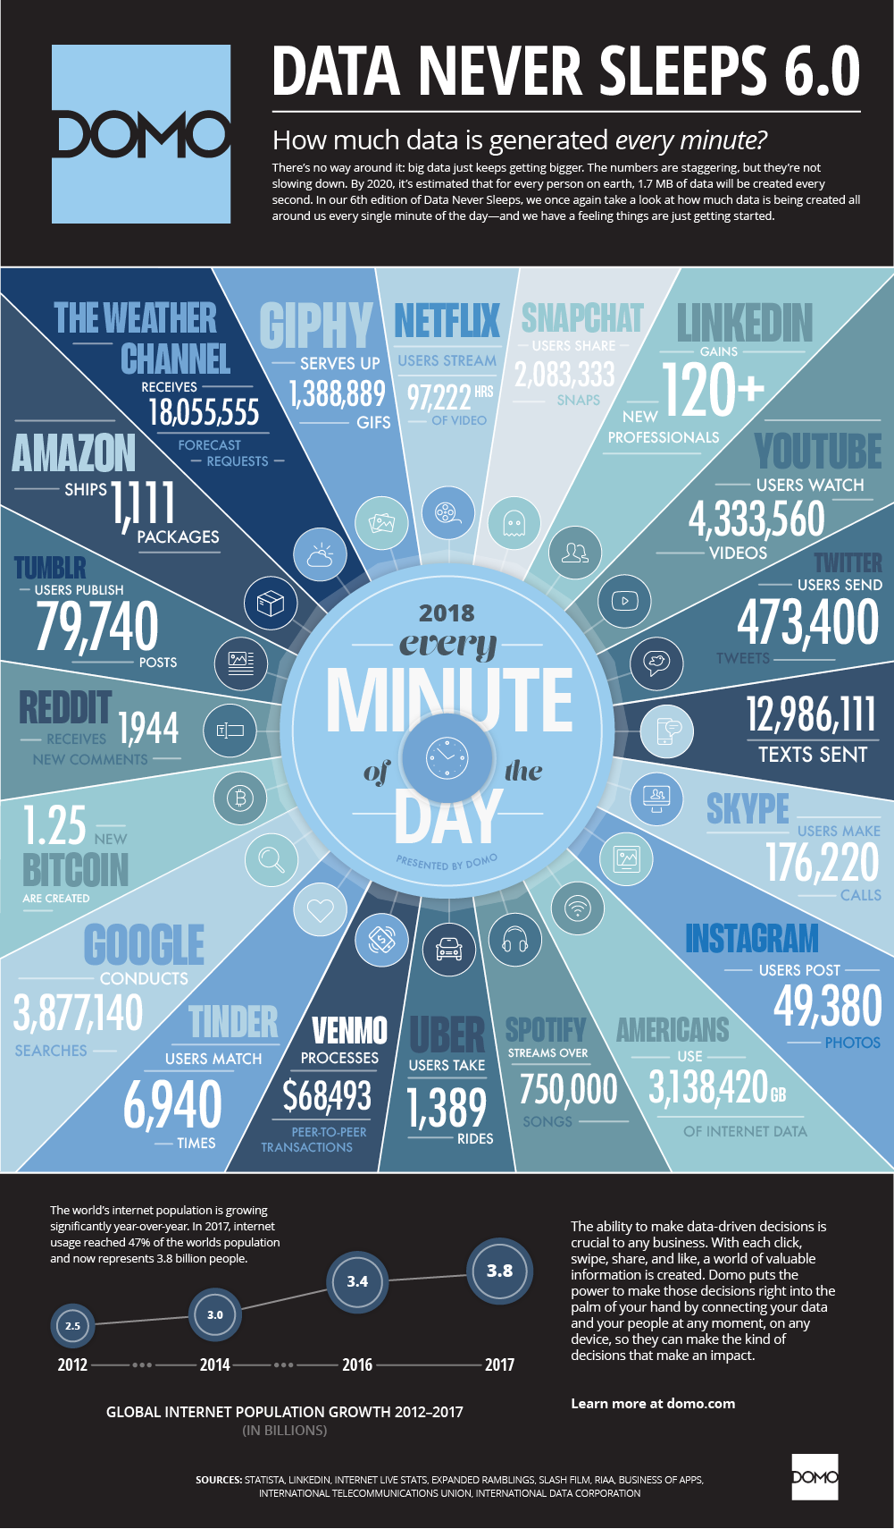
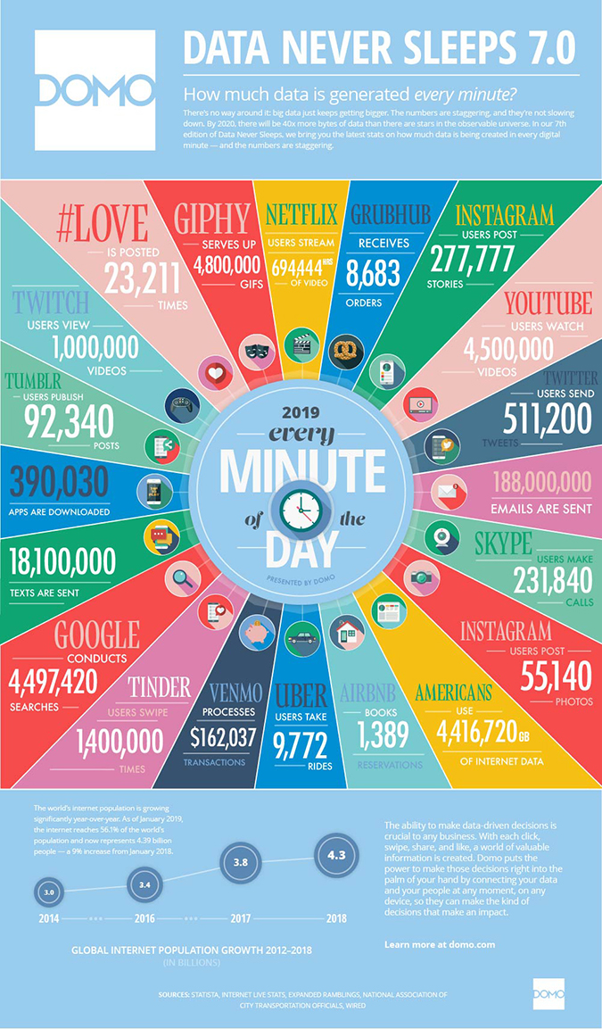
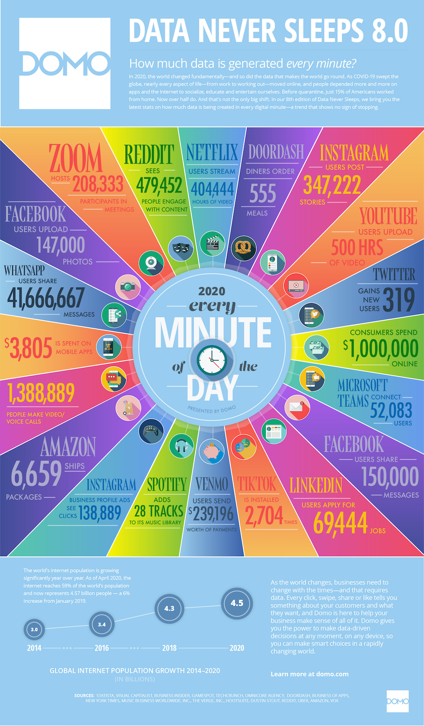
Why going cloud?
https://www.domo.com/learn/data-never-sleeps-8

Slide 60
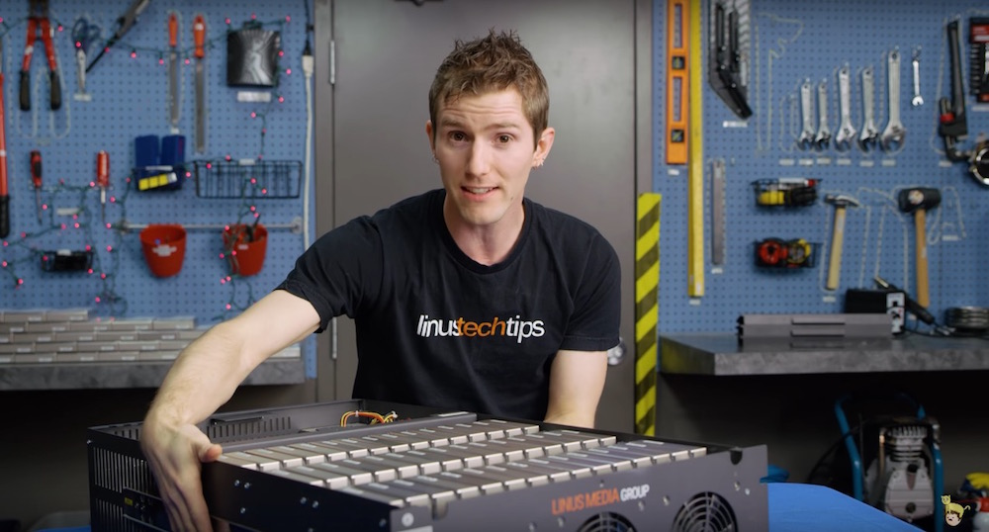
Why going cloud?
Hardware scalability
No longer think about rack space, switches, and power supplies, etc.
Grow storage from GBs to PBs
1PB: one hundred 10TB Enterprise Capacity 3.5 HDD hard drives
https://blog.seagate.com/business/linus-tech-tips-want-petabyte-system/

Slide 61
Why going cloud?
Resource pooling
Enable cost-sharing, a resource to serve different consumers
Resources are dynamically reassigned according to demands
Based on virtualization, running multiple virtual instances on top of a physical computer system
Economy of scale for physical resources
Reliability
Built to handle failures
Fault-tolerant or highly available

Slide 62
Why going cloud?
Worldwide deployment
Deploy applications as close to customers as possible
E.g., to reduce network latency
Improve data locality
Compliant to privacy regulations (e.g., GDPR)
Measured quality of service
Services leverage a quantitative qualitative metering capability making pay-as-you-go (or pay-per-use) billing and validation of the service quality available

Slide 63
Why going cloud?
Service integration
Do not reinvent the wheel, eliminate repetitive tasks
Use services that solve common problems (e.g., load balancing, queuing)
Abstract and automatically adapt the architecture to requirements
E.g., create (test) environments on demand
Integration and abstraction are drivers of change
From databases to data platforms
From on-premises to serverless architectures
From custom to standardized data pipelines

Slide 64
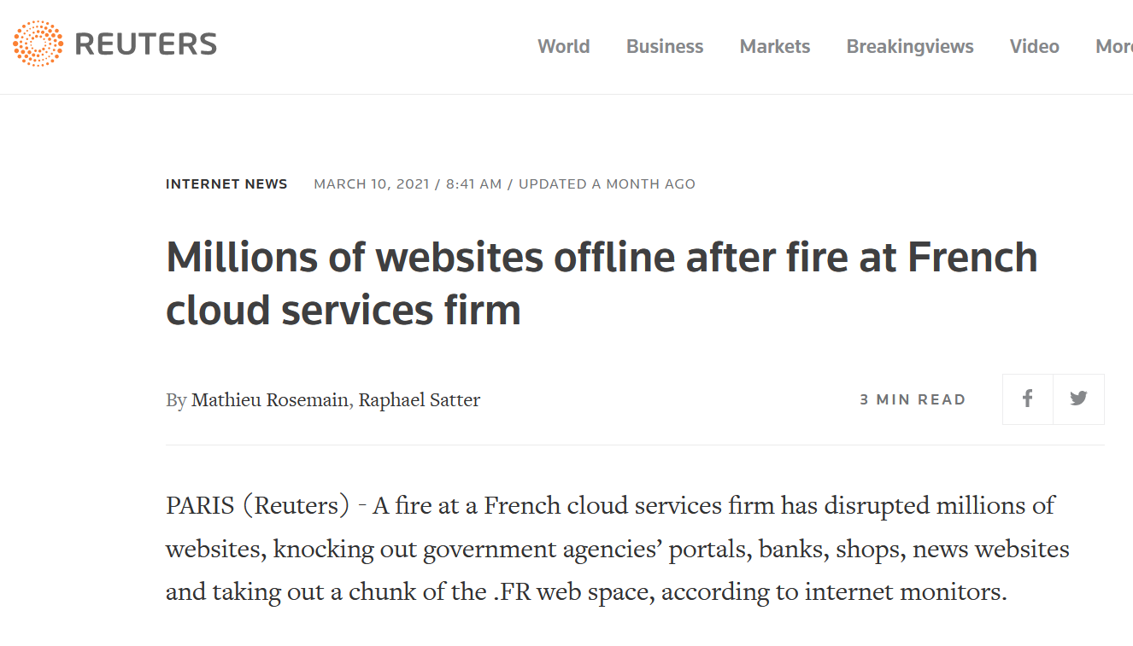
Is cloud a silver bullet?
https://www.reuters.com/article/us-france-ovh-fire-idUSKBN2B20NU

Slide 65
Is cloud a silver bullet?
Cloud computing is the outsourcing of a company’s hardware and software architecture
Which are the risks and issues?
Notes:
Google has a long track record on clean energy: in 2007, Google became the first major company to become carbon neutral. And in 2017, Google became the first company of our size to match 100% of its electricity consumption with renewable energy. Today, Google Cloud is the only major cloud provider to purchase enough renewable energy to cover our entire operations, and over the years, we’ve purchased more wind and solar power than any other corporation in history.
But wind and solar power don’t work in all places at all times. Though we buy enough renewable energy on average to match our data centers’ electricity consumption, that average is an annual average. Thus, for a particular data center, at any given time we may have too much renewable power, or too little. When we have too much, we feed it into the local grid so someone else can consume it. When we have too little, we draw power from the local grid, and that power may not be renewable.

Slide 66
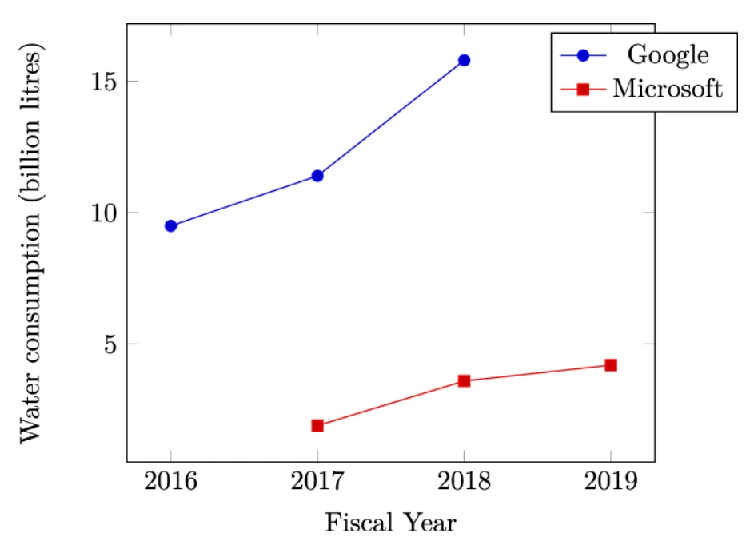
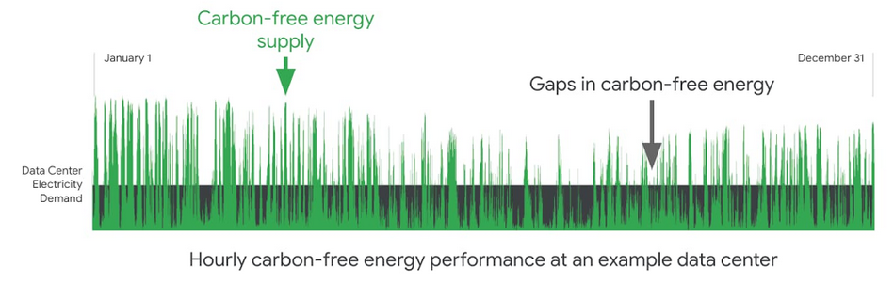
Is cloud a silver bullet?
Left: Mytton, David. "Data centre water consumption." npj Clean Water 4.1 (2021): 1-6. Right: https://cloud.google.com/blog/topics/inside-google-cloud/announcing-round-the-clock-clean-energy-for-cloud (accessed 2022-08-01)
Notes:
Google has a long track record on clean energy: in 2007, Google became the first major company to become carbon neutral. And in 2017, Google became the first company of our size to match 100% of its electricity consumption with renewable energy. Today, Google Cloud is the only major cloud provider to purchase enough renewable energy to cover our entire operations, and over the years, we’ve purchased more wind and solar power than any other corporation in history.
But wind and solar power don’t work in all places at all times. Though we buy enough renewable energy on average to match our data centers’ electricity consumption, that average is an annual average. Thus, for a particular data center, at any given time we may have too much renewable power, or too little. When we have too much, we feed it into the local grid so someone else can consume it. When we have too little, we draw power from the local grid, and that power may not be renewable.

Slide 67
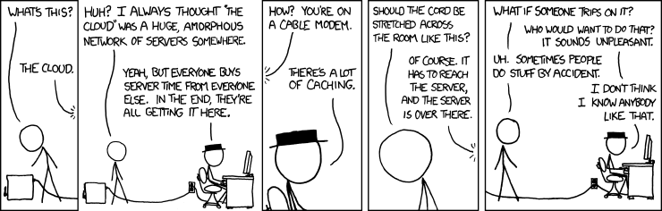
https://xkcd.com/908/

Slide 68
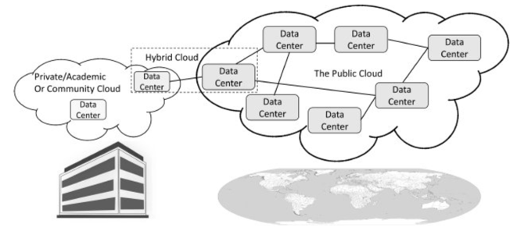
Cloud computing: types of cloud
There are different types of cloud
Public: accessible to anyone willing to pay (e.g., Microsoft, AWS, Google)
Private: accessible by individuals within an institution
In public cloud, any resources that you are not using can be used by other
Users share the costs
Cost-sharing disappears in private clouds
Hybrid: a mix of the previous

Slide 69
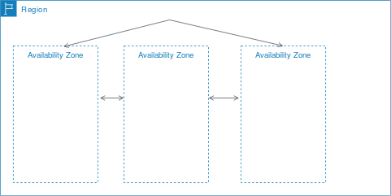
Cloud computing: types of cloud
Cloud services are hosted in separate geographic areas
Locations are composed of regions and availability zones
Region (e.g., us-east-1)
Is an independent geographical area that groups data centers
Has availability zones
Availability zones in a region
A data centner
Connected through low-latency links
Resources are usually replicated across zones but not regions
https://docs.aws.amazon.com/AWSEC2/latest/UserGuide/using-regions-availability-zones.html

Slide 70
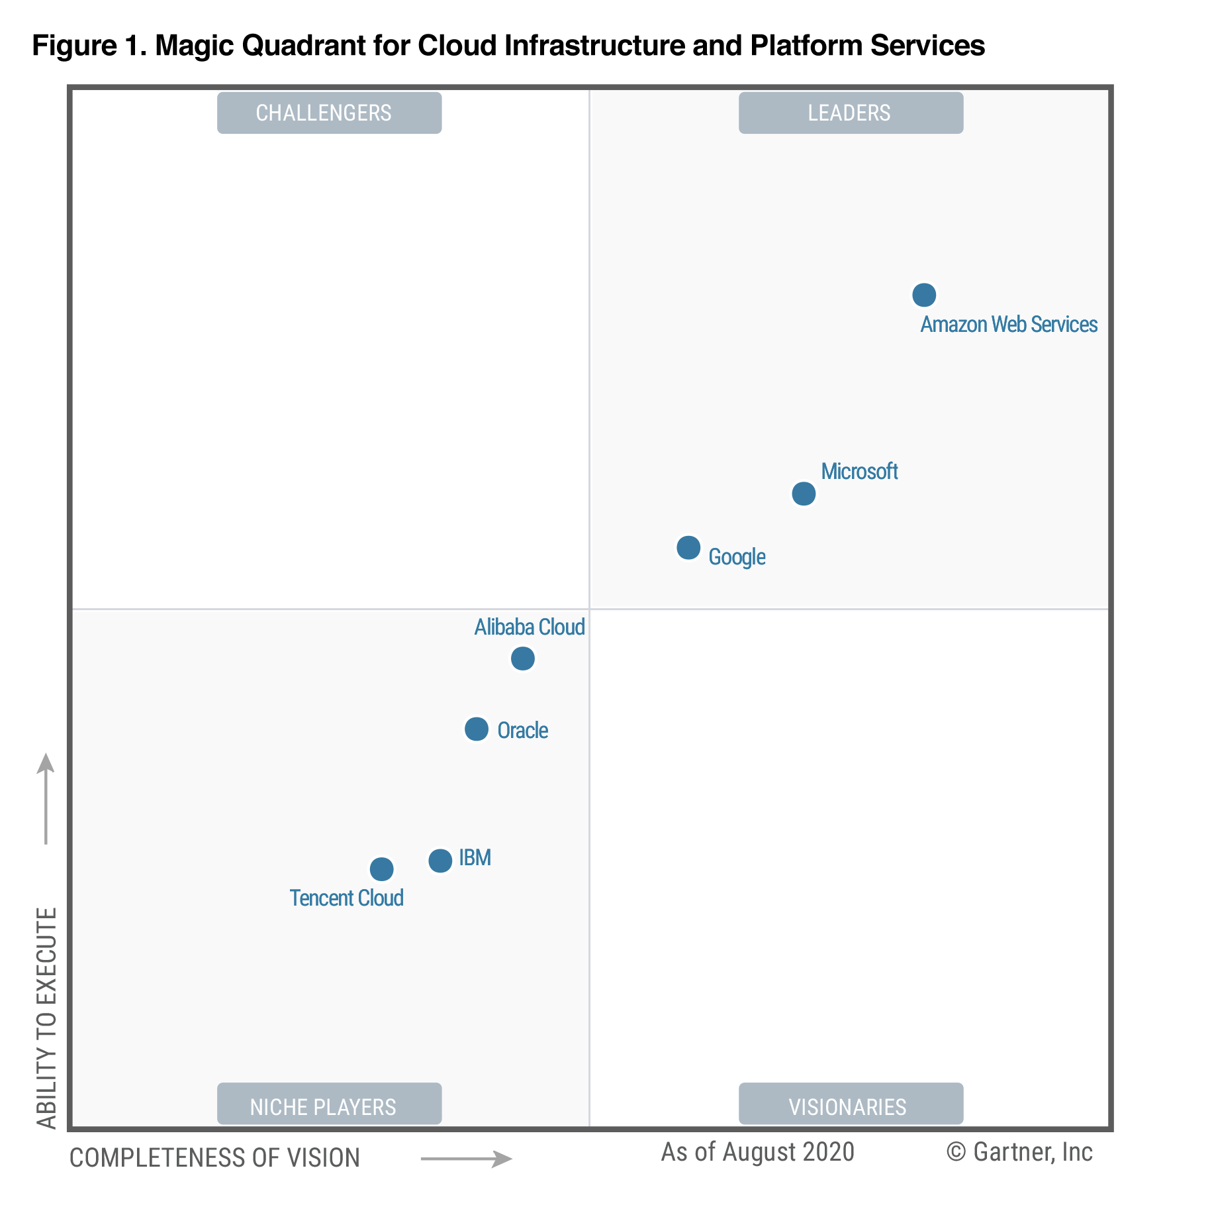
Cloud computing: principal vendors
Gartner Magic Quadrant
Understanding the technology providers to consider for an investment
Leaders execute well and are well positioned for tomorrow
Visionaries understand where the market is going but do not yet execute well
Niche Players focus successfully on a small segment, or are unfocused and do not out-innovate or outperform others
Challengers execute well but do not demonstrate an understanding of market direction
Focusing on leaders isn’t always the best
A niche player may support needs better than a market leader. It depends on how the provider aligns with business goals
https://www.gartner.com/en/research/methodologies/magic-quadrants-research

Slide 71
Cloud computing: deployment models
On a cloud architecture, you can rely on serverless or managed services
Serverless
Standalone independent services built for a specific purpose and integrated by cloud service provider
No visibility into the machines
There are still servers in serverless, but they are abstracted away
No server management, do not have to manage any servers or scale them
E.g., when you run a query on BigQuery you do not know how many machines were used
Pay for what your application uses, usually per request or per usage
(Fully) Managed
Visibility and control of machines
You can choose the number of machines that are being used to run your application
Do not have to set up any machines, the management and backup are taken care for you
Pay for machine runtime, however long you run the machines and resources that your application uses
https://cloud.google.com/blog/topics/developers-practitioners/serverless-vs-fully-managed-whats-difference (accessed 2020-08-01)

Slide 72
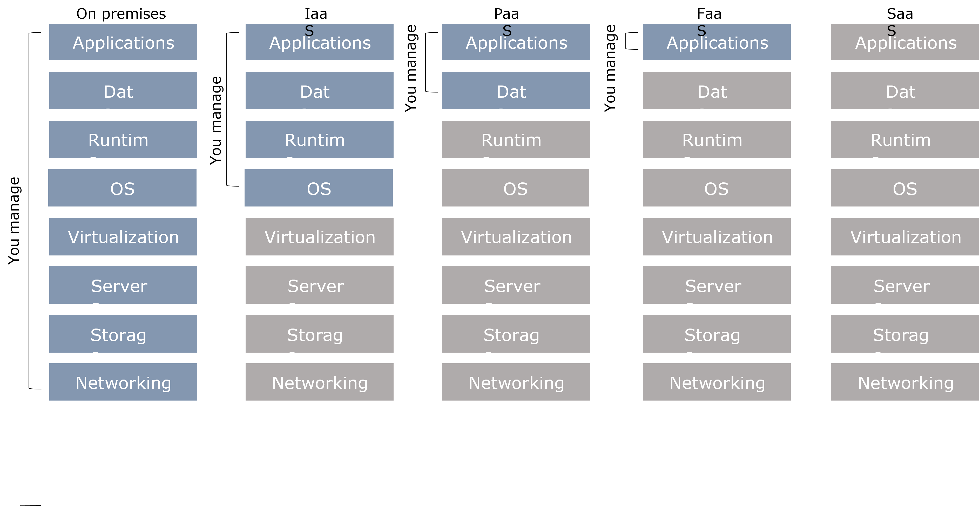
Cloud computing: deployment models
Understanding architectures is paramount to successful systems
Good architectures help to scale
Poor architectures cause issues that necessitate a costly rewrite
XaaS (anything as a service)
A collective term that refers to the delivery of anything as a service
It encompasses the products, tools and technologies that vendors deliver to users

Slide 73
Cloud computing: deployment models
On-premises
Provisioning servers is time-consuming
A non-trivial environment is hard to set up
Require dedicated operations people
Often a distraction from strategic tasks
On premises
Applications
Data
Runtime
OS
manage
Virtualization
You
Servers
Storage
Networking

Slide 74
Cloud computing: deployment models
Infrastructure as a service (IaaS)
A computing infrastructure provisioned and managed over the internet (e.g., AWS EC2)
Avoid expense/complexity of buying/managing physical servers/data-centers
IaaS overcomes issues on-premises
Possibly requires to manage many environments
IaaS
Applications
Data
manage
Runtime
You
OS
Virtualization
Servers
Storage
Networking

Slide 75
Cloud computing: deployment models
Platform as a Service (PaaS)
A development and deployment environment in the cloud (e.g., AWS Elastic Beanstalk)
Support complete application life-cycle: building, testing, deploying, etc.
Avoid expense/complexity of managing licenses and application infrastructure
PaaS
Applications
manage
You
Data
Runtime
OS
Virtualization
Servers
Storage
Networking

Slide 76
Cloud computing: deployment models
PaaS and containers are potential solutions to inconsistent infrastructures
PaaS provides a platform for users to run their software
Developers write software targeting features/capabilities of the platform
Containerization isolates an application with its own environment
Lightweight alternative to full virtualization
Containers are isolated but need to be deployed to (public/private) server
Excellent solution when dependencies are in play
Housekeeping challenges and complexities

Slide 77

Cloud computing: deployment models
Containers and virtual machines are packaged computing environments
Containers
On top of physical server and its host OS
Share the host OS kernel
Shared components are read-only
“Light”, take seconds to start
Virtual machines
Emulate a hardware/software system
On top of a hypervisor (VM monitor)

Slide 78
Cloud computing: deployment models
Function as a Service (FaaS)
A coding environment, cloud provider provisions platform to run the code (e.g., AWS Lambda)
Infrastructure provisioning and management are invisible to the developer
FaaS
Applications
manage
You
Data
Runtime
OS
Virtualization
Servers
Storage
Networking

Slide 79
Cloud computing: deployment models
Principles of FaaS architectures
FaaS is based on a serverless approach, use a compute service to execute code on demand
Every function could be considered as a standalone service
Write single-purpose stateless functions
Functions react to events
Design push-based, event-driven pipelines
Create thicker, more powerful front ends
Embrace third-party services (e.g., security)
FaaS is not a silver bullet
Not appropriate for latency-sensitive applications
Strict specific service-level agreements
Migration costs
Vendor lock-in can be an issue

Slide 80
Cloud computing: deployment models
Software as a service (SaaS)
An application environment
Access cloud-based apps over the Internet (e.g., email, Microsoft Office 365)
SaaS
Applications
Data
Runtime
OS
Virtualization
Servers
Storage
Networking

Slide 81
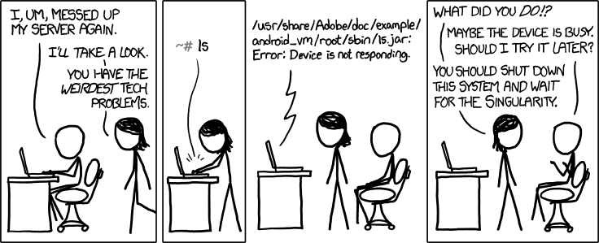
https://xkcd.com/1084/

Slide 82
BIG DATA AND CLOUD PLATFORMS
California housing prices
Notes:
https://catalog.us-east-1.prod.workshops.aws/workshops/ea7ddf16-5e0a-4ec7-b54e-5cadf3028b78/en-US

Slide 83
Integrated analytics lab
This checklist can help you while building your data pipelines
Frame the problem and look at the big picture
Get the data
Explore the data to gain insights
Prepare the data
Explore many different models and shortlist the best ones
Fine-tune your models and combine them
Present your solution
Launch, monitor, and maintain your system

Slide 84
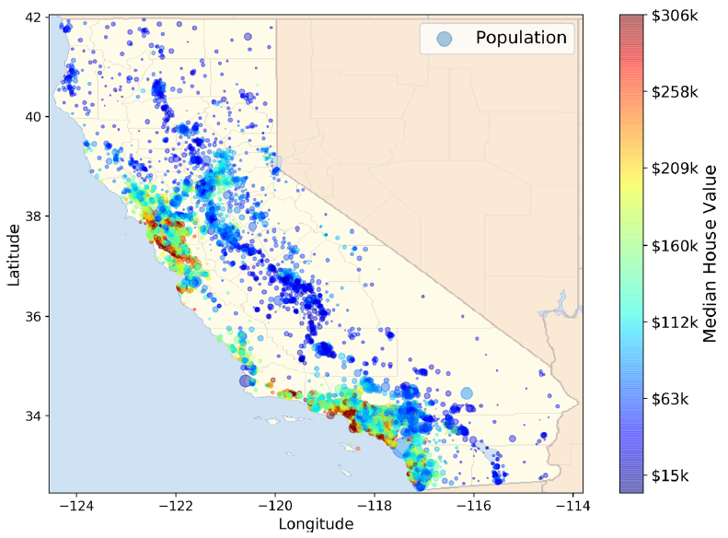
Integrated analytics lab
This checklist can help you while building your projects
Frame the problem and look at the big picture
"We’ll use the California Housing Prices. Our task is to use California census data to forecast housing prices given the population, median income, and median housing price for each block group in California. Block groups are the smallest geographical unit for which the US Census Bureau publishes sample data (a block group typically has a population of 600 to 3,000 people)"

Slide 85
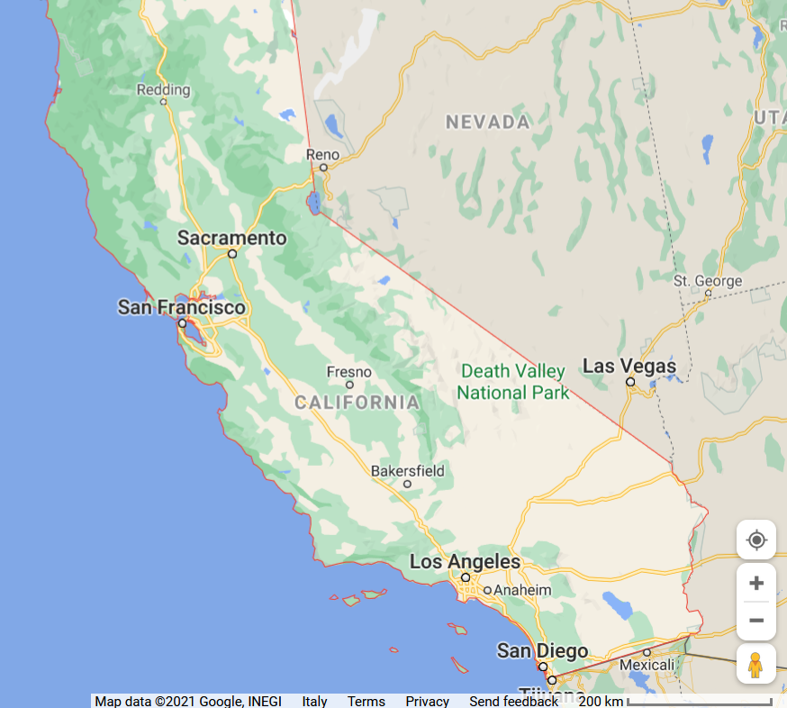
Integrated analytics lab

Slide 86
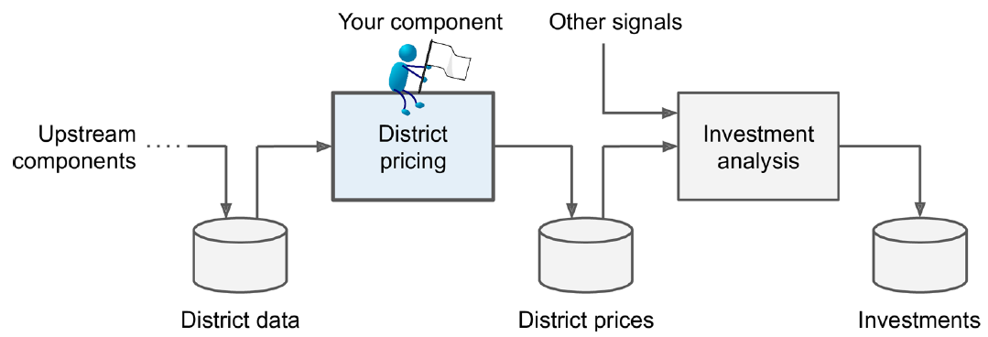
Integrated analytics lab
This checklist can help you while building your projects
Frame the problem and look at the big picture
Knowing the objective is important because it will determine how you frame the problem, which algorithms you will select, which performance measure you will use to evaluate your model, and how much effort you will spend tweaking it.
"Your boss answers that your model’s output (a prediction of a district’s median housing price) will be fed to another Machine Learning system, along with many other signals. This downstream system will determine whether it is worth investing in a given area or not. Getting this right is critical, as it directly affects revenue."

Slide 87
Integrated analytics lab
This checklist can help you while building your projects
Frame the problem and look at the big picture
✔Define the objective in business terms
✖How should performance be measured? (postponed for later)
Get the data
✔ List the data you need and how much you need
In typical environments your data would be available in a relational database (or some other common data store) and/or spread across multiple tables/documents/files
In this project, however, things are much simpler
Explore the data to gain insights
✔ Create an environment to keep track of your data exploration
You have been provided with notebook environments
✔ Study each attribute and its characteristics
Let's do this!

Slide 88
In action
https://colab.research.google.com/drive/1c9umVM8b3hHkY1mZEJLNOKH1OhXbEwZr?usp=sharing

Slide 89
BIG DATA AND CLOUD PLATFORMS
Building data pipelines

Slide 90
Reference scenario
The big-data cube
Volume: small to big
Variety: structure to unstructured
Velocity: pull to push
Small
Volume
Structured
Big
Variety
(data model)
Unstructured
High
Velocity
Low
(pull)
(
(
push
latency
)
)
Meijer, Erik. "Your mouse is a database." Communications of the ACM 55.5 (2012): 66-73.

Slide 91
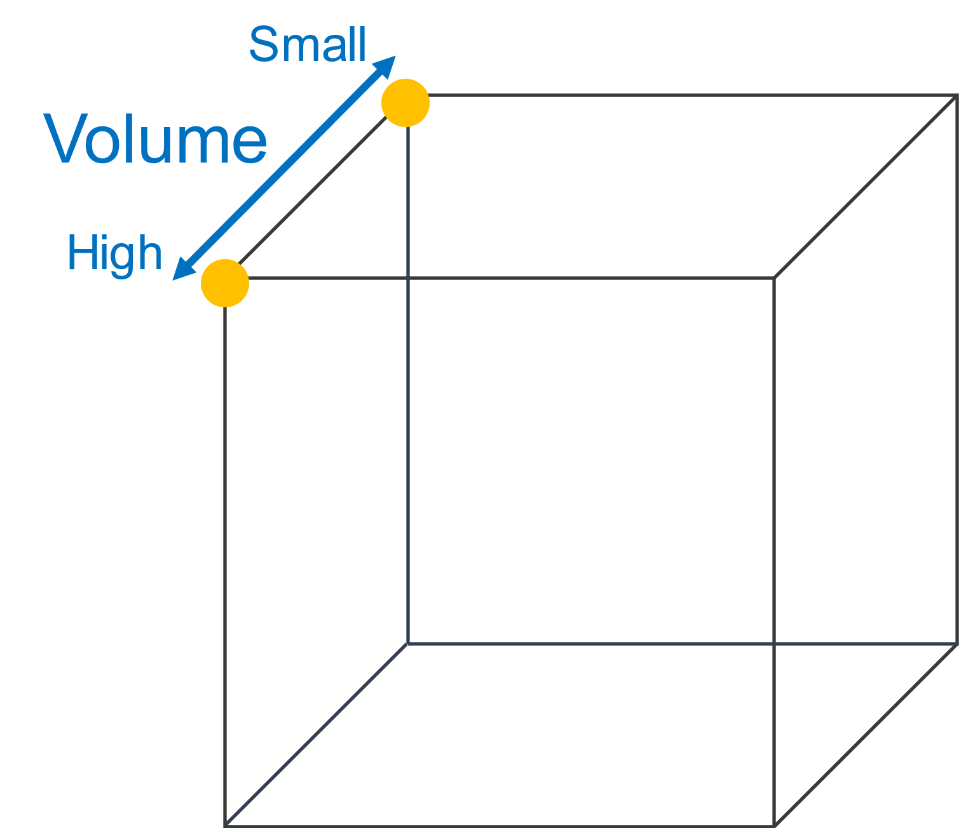
Reference scenario
Volume
Small: small relational DBs
High: TBs o PBs of data

Slide 92
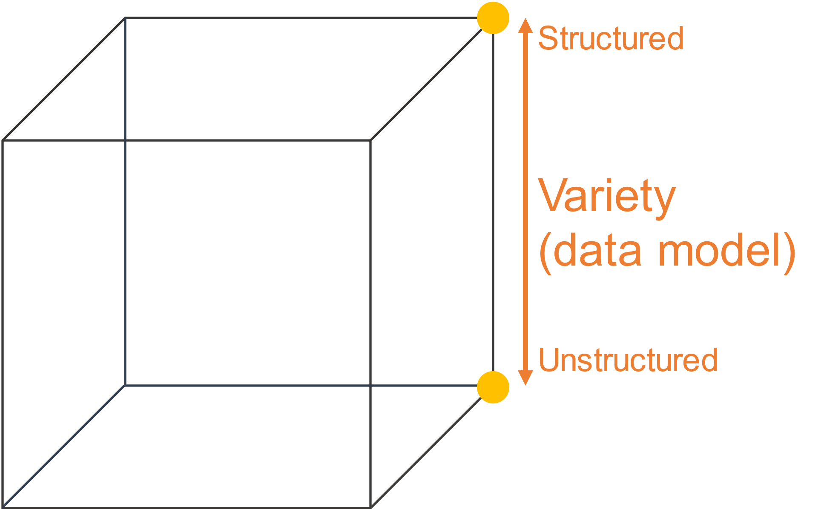
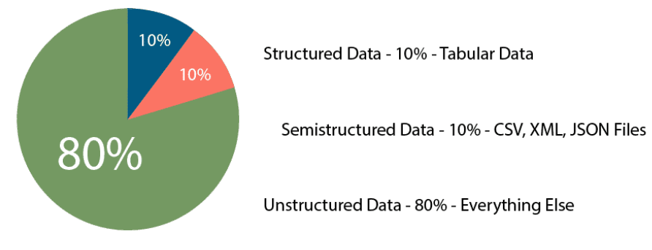
Reference scenario
Variety
Structured
Relational tuples with FK/PK relationships
Unstructured
Key-value
Columnar
Document-based
Graph
...
https://www.datamation.com/big-data/structured-vs-unstructured-data/ (accessed 2022-08-01)

Slide 93
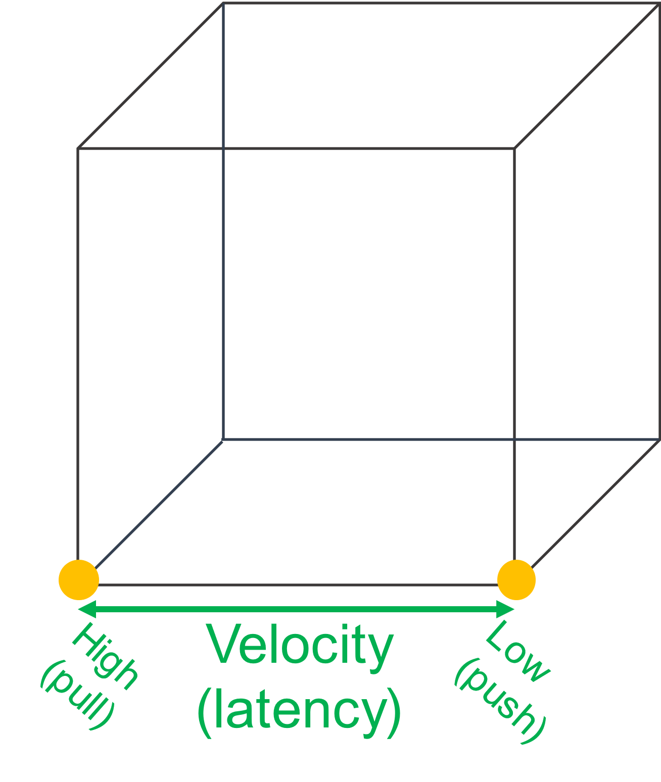
Reference scenario
Velocity (latency)
High: clients synchronously pulling data from sources
Low: sources asynchronously pushing data to clients
Velocity (speed; dual to latency)
High: processing in real-time (milliseconds) or near-real time (minutes)
Low: processing can take hours

Slide 94
Reference scenario
Collecting data
Processing data
Scheduled Batch
Large volume of data processed on a regular scheduled basis; velocity is very predictable
Periodic:
Large volume of data processed at irregular times (e.g., after collecting a certain amount of data); velocity is less predictable
Near real-time
Streaming data processed in small individual batches that are collected and processed within minutes; velocity is a huge concern
Real-time
Streaming data processed in very small individual batches that are collected and processed within milliseconds; velocity is the paramount concern
Batch and periodic
Once data has been collected, processing can be done in a controlled environment
There is time to plan for the appropriate resources
Near real-time and real-time
Collection of the data leads to an immediate need for processing.
Depending on the complexity of the processing (cleansing, scrubbing, curation), this can slow down the velocity of the solution significantly
Plan accordingly

Slide 95
Reference scenario
Data acceleration
The rate at which large collections of data can be ingested, processed, and analyzed
Data acceleration is not constant, it comes in bursts
Take Twitter as an example
Hashtags can become hugely popular and appear hundreds of times in just seconds
… or slow down to one tag an hour
Your system must be able to efficiently handle the peak as well as the lows

Slide 96
Reference scenario
Plus other Vs
Veracity: data trustworthiness/quality
Value: ability to extract meaningful information
Do you foresee any related problem?
Our focus
(Un)Structured big-data batch
(Un)Structured big-data streams
Goal: keep in mind the cube to
categorize the services
Small
Volume
Structured
Big
Variety
(data model)
Batch
Stream
Unstructured
High
Velocity
Low
(pull)
(
(
push
latency
)
)

Slide 97
Reference scenario: batch vs stream

Slide 98
Reference scenario: batch vs stream
 | Batch data processing | Stream data processing
Data scope | Queries or processing over all or most of the data in the dataset | Queries or processing over data within a rolling time window, or on just the most recent data record
Data size | Large batches of data | Individual records or micro batches consisting of a few records
Latency | Minutes to hours | Seconds or milliseconds
Analysis | Complex analytics | Simple response functions, aggregates, and rolling metrics

Slide 99
Reference scenario
Scenario 1
My business has a set of 15 JSON data files that are each about 2.5 GB in size.
They are placed on a file server once an hour, and they must be ingested as soon as they arrive in this location.
Data must be combined with all transactions from financial dashboard for this same period, then compared to the recommendations from marketing engine
All data is fully cleansed.
The results from this time period must be made available to decision makers by 10 minutes after the hour in the form of financial dashboards.
Which Vs are involved?

Slide 100
Reference scenario
Scenario 1
My business has a set of 15 JSON data files that are each about 2.5 GB in size.
They are placed on a file server once an hour, and they must be ingested as soon as they arrive in this location.
Data must be combined with all transactions from financial dashboard for this same period, then compared to the recommendations from marketing engine
All data is fully cleansed.
The results from this time period must be made available to decision makers by 10 minutes after the hour in the form of financial dashboards.
Which Vs are involved?
Volume This scenario describes huge JSON files to be combined with transactional data and marketing data.
Velocity "Wait - now hurry up!" Wait to collect data for a full hour and then produce meaningful results in 10 minutes (is it batch or stream processing?)
Variety three data source types: log files, transactional data, and recommendation information
Value populate dashboards that are used by decision makers as soon as they are made available. The value is reached because it requires an understanding of what the organization is trying to accomplish

Slide 101
Reference scenario
Scenario 2
My business compiles data generated by hundreds of corporations.
This data is delivered to us in very large files, transactional updates, and even data streams.
The data must be cleansed and prepared to ensure that rogue inputs do not skew the results.
Knowing the data source for each record is vital to the work we do.
A large portion of the data gathered is irrelevant to our analysis, so this data must be eliminated.
The final requirement is that all data must be combined and loaded into our data warehouse, where it will be analyzed.
Which Vs are involved?

Slide 102
Reference scenario
Scenario 2
My business compiles data generated by hundreds of corporations.
This data is delivered to us in very large files, transactional updates, and even data streams.
The data must be cleansed and prepared to ensure that rogue inputs do not skew the results.
Knowing the data source for each record is vital to the work we do.
A large portion of the data gathered is irrelevant to our analysis, so this data must be eliminated.
The final requirement is that all data must be combined and loaded into our data warehouse, where it will be analyzed.
Which Vs are involved?
Volume The data is delivered in very large files, transactional updates, and even in data streams
Variety The business will need to combine the data from all three sources into a single data warehouse.
Veracity The data is known to be suspect. The data must be cleansed and prepared to ensure that rogue inputs do not skew the results. Knowing the data source for each record is vital to the work we do.

Slide 103
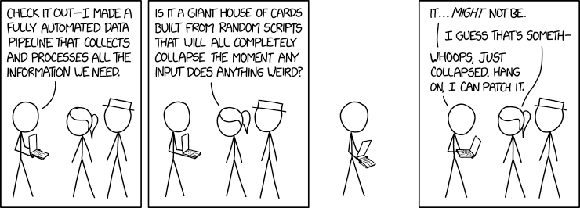
Data pipeline
Data pipeline
"A succession of operations to transform and consume raw data"
https://xkcd.com/2054/
Quemy, Alexandre. "Data Pipeline Selection and Optimization." DOLAP. 2019.

Slide 104
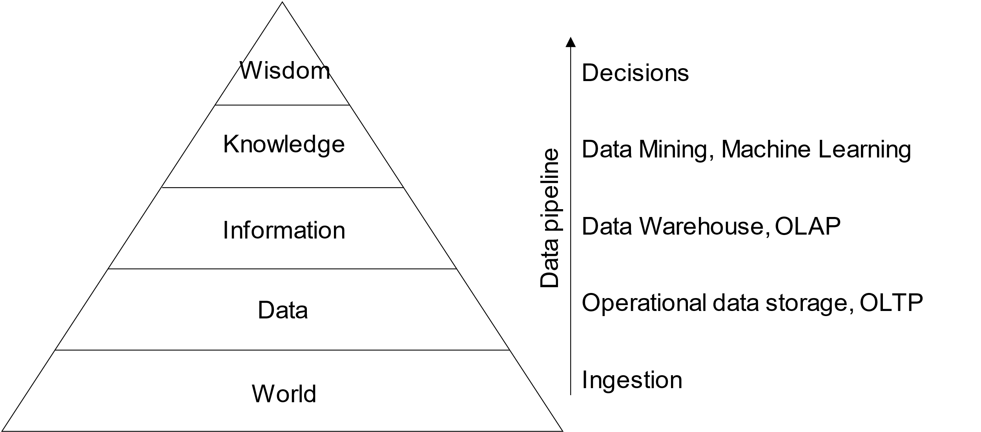
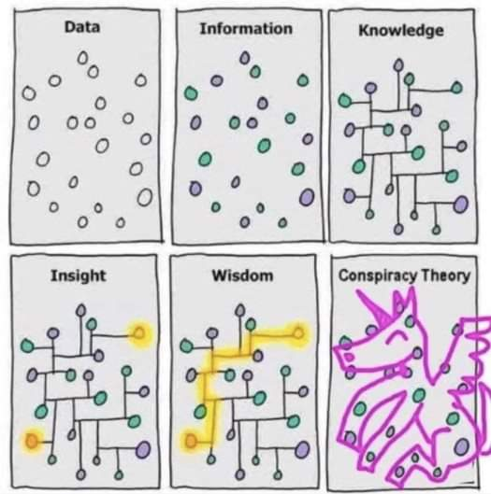
Data pipeline
DIKW hierarchy
Layers representing structural relationships between data, information, knowledge, and wisdom
Ackoff, Russell L. "From data to wisdom." Journal of applied systems analysis 16.1 (1989): 3-9.

Slide 105
Data pipelines on cloud
The pyramid abstracts tons of techniques, algorithms, etc.
To provide them as services, architecting data pipelines on cloud requires
Standardization (of common services)
Integration
Orchestration
Accessibility through simple APIs
Let us look to data pipelines on different cloud services providers

Slide 106
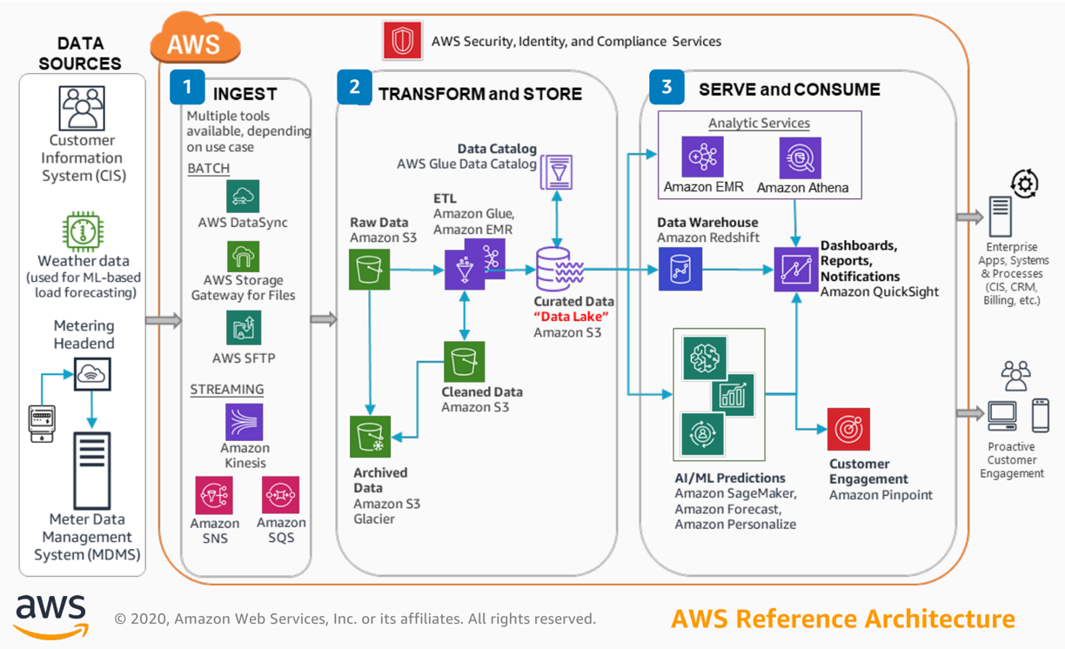
Data pipeline - AWS
Three main categories
Ingest
Gateway, DataSync (batch)
Kinesis, SNS, SQS (stream)
Transform and store
S3 and Glacier (storage)
Glue (ETL)
Serve and consume
EMR (Hadoop-like cluster)
Athena (serverless query service to analyze data in Amazon S3)
(Many) Machine learning services
https://console.aws.amazon.com/console

Slide 107
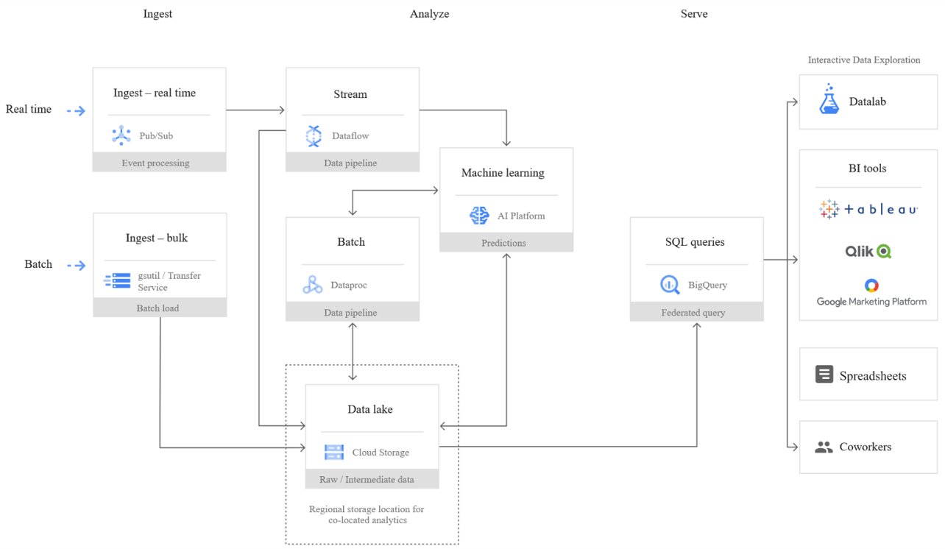
Data pipeline - Google cloud
Three main categories
Ingest
Transfer service (batch)
Pub/Sub (stream)
Analyze
Dataproc (batch)
Dataflow (stream)
Cloud storage (storage)
Machine learning services
Serve
BigQuery (query service)

Slide 108
A tentative organization
Two main ways to consume data:
Querying produces results that are great for quick analysis by data analysts.
BI tools produce visualizations that are grouped into reports and dashboards to help users explore data and determine the best actions to take
Common points
We have services
Which transforms data
Recall the DIKW pyramid
Which supports data transformation
Data pipelines are based on
Ingesting data
Analyzing data
Serving data
Transforming data to make it consumable this usually means sorting, aggregating, joining, and applying business logic to produce meaningful analytical data sets. The final step is to load this analytical data set into a new storage location, like a data lake, database, or data warehouse.
Data
transformation
Supporting services
Serve (deciding/consume)
•
SQL
•
BI tools (e.g., Tableau)
Collecting raw data from
transactions
logs
IoT devices is a challenge.
A good data analysis solution allows developers to ingest a wide variety of data at any speed, from batch to streaming
Analytics (analyzing/process)
Storage
•
Processing
(organizing)
Security
•
File
•
Access Control
Networking, etc.
•
Batch
•
Authorization
Computing
•
Streaming
•
Object
•
Machine learning
•
DB
Ingestion (acquiring/collect)
•
Batch
•
Streaming

Slide 109
A tentative organization
Orchestration
Fast storage
Ingestion
Real-time processing and analytics
Data consumers
Streaming data
Operational metadata
Data warehouse
Data consumers
Batch
data
Batch processing and analytics
Slow storage (data lake)
Data consumers
ETL tools overlay

Slide 110
A tentative organization
This is not a sharp taxonomy
Ingestion vs Analytics
Data streams are used for ingestion
... and (event) processing
Data
transformation
Supporting services
Serve (deciding)
•
SQL
•
BI tools (e.g., Tableau)
Analytics (analyzing)
Storage
•
Processing
(organizing)
Security
•
File
•
Access Control
Networking, etc.
•
Batch
•
Authorization
Computing
•
Streaming
•
Object
•
Machine learning
•
DB
Ingestion (acquiring)
•
Batch
•
Streaming

Slide 111
A tentative organization
This is not a sharp taxonomy
Storage vs Serving
Databases are storage
... with processing capability
... and with serving capability
Data
transformation
Supporting services
Serve (deciding)
•
SQL
•
BI tools (e.g., Tableau)
Analytics (analyzing)
Storage
•
Processing
(organizing)
Security
•
File
•
Access Control
Networking, etc.
•
Batch
•
Authorization
Computing
•
Streaming
•
Object
•
Machine learning
•
DB
Ingestion (acquiring)
•
Batch
•
Streaming

Slide 112
A tentative organization
Data
transformation
Supporting services
Serve (deciding)
•
SQL
•
BI tools (e.g., Tableau)
Analytics (analyzing)
Storage
•
Processing
(organizing)
Security
•
File
•
Access Control
Networking, etc.
•
Batch
Computing
•
Streaming
•
Object
•
Authorization
•
Machine learning
•
DB
Ingestion (acquiring)
•
Batch
•
Streaming

Slide 113
Storage
Goal: persisting data
Which storage do we choose?
Storage model (or data model) ~= variety
How data are organized/accessed in a storage system
Structured vs unstructured
Data access model (key-value, column, etc.)
Access frequency
Analyses to be performed

Slide 114
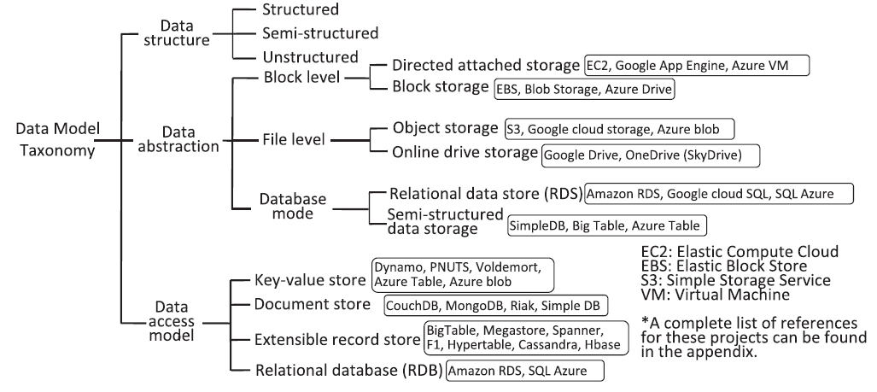
Storage models
Mansouri, Yaser, Adel Nadjaran Toosi, and Rajkumar Buyya. "Data storage management in cloud environments: Taxonomy, survey, and future directions." ACM Computing Surveys (CSUR) 50.6 (2017): 1-51.

Slide 115
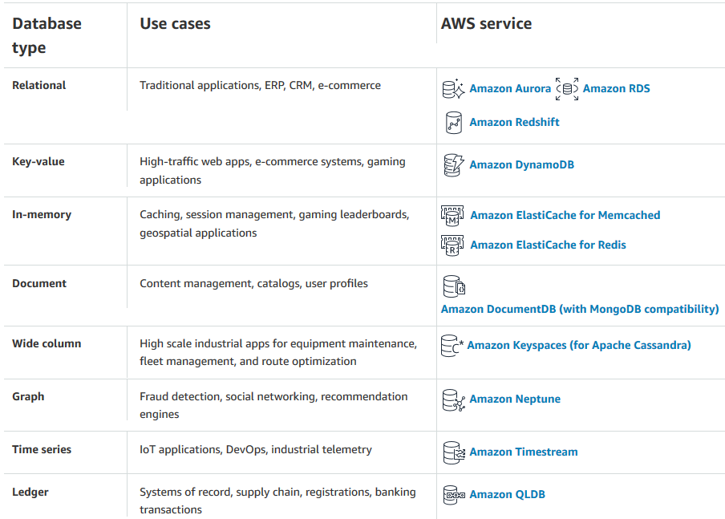
Storage models (AWS)
Data structure: structured
Data abstraction: database
Data access model: relational
Relational
Store data with predefined schemas and relationships between them
Support ACID transactions
Maintain referential integrity
https://aws.amazon.com/products/databases/

Slide 116
Storage models (AWS)
Data structure: semi/unstructured
Data abstraction: database
Data access model: *
Key/value: store and retrieve large volumes of data
Document : store semi-structured data as JSON-like documents
Columnar: use tables but unlike a relational database, columns can vary from row to row in the same table
Graph: navigate and query relationships between highly connected datasets
... and more
https://aws.amazon.com/products/databases/

Slide 117


Storage models (Google Cloud)
https://cloud.google.com/products/databases

Slide 118
Storage models (AWS)
Data structure: unstructured
Data abstraction: file (or database)
Data access model: key-value
File system (EFS), object storage (S3) (or DB K-V; e.g., DynamoDB)
Handle unstructured data
... organized as files (or blob)
... accessed using a key-value
Differ in the supported features
E.g., maximum item size (DynamoDB: 400KB, S3: 5TB)
E.g., indexes, querying mechanisms, latency, etc.

Slide 119
AWS S3
Simple Storage Service (S3)
Amazon S3 stores data as objects within buckets.
An object is composed of a file and any metadata that describes that file
Once objects have been stored in an Amazon S3 bucket, they are given an object key. Use this, along with the bucket name, to access the object.
Buckets are logical containers for objects
You can have one or more buckets in your account
Control access for each bucket individually
Choose the geographical region where Amazon S3 will store the bucket and its contents
Benefits
Centralized data architecture (create a single—trustworthy—dataset)
Build a multi-tenant environment, where many users can bring their own data
Improve both cost and data governance over traditional solutions
Although this may require an additional step to load your data into S3
Decoupling of storage from compute and data processing.
You can cost-effectively store all data types in their native formats
Then, launch as many virtual servers needed or analytics tools needed to process your data

Slide 120
AWS Redshift
Datawarehouse on AWS…
But what if we want to query data from the data lake as well? AWS Redshift Spectrum
HADOOP is a framework to both store and process data
EMR uses its own filesystem, we can use S3

Slide 121

Storage: access frequency (AWS)
Object storage (AWS S3) classes
Standard: general purpose
Infrequent (rapid) access
One Zone-IA: lower-cost option for infrequently accessed data that do not require high availability and resilience
Glacier: low-cost storage class for data archiving, three retrieval options that range from a few minutes to hours
Deep Glacier: long-term retention for data accessed once or twice in a year. E.g., retain data sets for 10 years or longer
Intelligent-Tiering: move objects between access tiers when access patterns change
https://aws.amazon.com/s3/storage-classes/

Slide 122
Storage: access frequency (AWS)
Transition
Lifecycle configuration
A set of rules that define actions that Amazon S3 applies to a group of objects
Two types of actions:
Transition: when objects transition to another storage class. E.g., archive objects to the S3 Glacier storage class one year after creating them
Expiration: when objects expire. Amazon S3 deletes expired objects on your behalf
https://docs.aws.amazon.com/AmazonS3/latest/userguide/object-lifecycle-mgmt.html

Slide 123


Storage: access frequency (Google Cloud)
https://cloud.google.com/blog/products/storage-data-transfer/archive-storage-class-for-coldest-data-now-available

Slide 124
Organizing the data lake
Having a consistent principles on how to organize your data is important
To build standardized pipelines with the same design with regard to where read/write data
Standardization makes it easier to manage your pipelines at scale
Helps data users search for data in the storage and understand exactly to find what they need
Decoupling storage from processing
Failed
Landing
Archive
Staging
Production
Data Product 1
Data Product n
DWH

Slide 125
Organizing the data lake
Landing area (LA)
Save raw data from ingestion
Transient, data is not stored for long term
Staging area (SA)
Raw data goes through a set of common transformations: ensuring basic quality and making sure it conforms to existing schemas for this data source and then data is saved into SA
Archive area (A)
After saving into SA, raw data from LA should be copied into the archive to reprocess any given batch of data by simply copying it from AA into LA
Useful for debugging and testing
Failed
Landing
Archive
Staging
Production
Data Product 1
Data Product n
DWH

Slide 126
Organizing the data lake
Production area (PA)
Apply the business logic to data from SA
Pass-through job
Copy data from SA to PA and then into DWH without applying any business logic
Optional, but having a data set in the data warehouse and PA that is an exact replica can be helpful when debugging any issues with the business logic
Cloud data warehouse (DWH)
Failed area (FA)
You need to be able to deal with all kinds of errors and failures
There might be bugs in the pipeline code, cloud resources may fail
Failed
Landing
Archive
Staging
Production
Data Product 1
Data Product n
DWH

Slide 127


Slide 128
Organizing the data lake
Area | Permissions | Tier
Landing | Ingestion applications can write Scheduled pipelines can read Data consumers can’t access | Hot
Staging | Scheduled pipelines can read/write Selected data consumers can read | Hot
Production | Scheduled pipelines can read/write Selected data consumers can read | Hot
Archive | Scheduled pipelines can write Dedicated data reprocessing pipelines can read | Cold or archive
Failed | Scheduled pipelines can write Dedicated data reprocessing pipelines can read Data consumers don’t have access | Hot

Slide 129
Organizing the data lake
Use folders to organize data inside areas into a logical structure
Namespace
Logically group multiple pipelines together.
Pipeline name
Each data pipeline should have a name that reflects its purpose. For example
A pipeline that takes data from the LA, applies common processing steps, and saves data into SA
You will also have one for archiving data into AA
Data source name
Ingestion layer will assign a name to each data source you bring into the platform
BatchId
Unique identifier for any batch of data that is saved into LA
E.g., Since only ingestion can write to LA, it is its responsibility to generate this identifier
A common choice for this type of an identifier is a Universally Unique Identifier (UUID)
Different areas will have slightly different folder structures
/landing/ETL/sales_oracle_ingest/customers/01DFTFX89YDFAXREPJTR94

Slide 130
A tentative organization
Data
transformation
Supporting services
Serve (deciding)
•
SQL
•
BI tools (e.g., Tableau)
Analytics (analyzing)
Storage
•
Processing
(organizing)
Security
•
File
•
Access Control
Networking, etc.
•
Batch
Computing
•
Streaming
•
Object
•
Authorization
•
Machine learning
•
DB
Ingestion (acquiring)
•
Batch
•
Streaming

Slide 131
Bulk vs. Streaming systems
What is a bulk processing system?
High latency
Exact results
Process massive data at once
... is this true?
What is a streaming system?
Low latency
Approximate result
... is this true?
Process data item by data item
... is this true?

Slide 132
Bulk vs. Streaming systems
What is a bulk processing system?
An engine capable to handle processing on bounded datasets
What is a streaming system?
An engine capable to handle processing on unbounded datasets
Streaming is a superset of batch processing
Akidau, Tyler, Slava Chernyak, and Reuven Lax. Streaming systems: the what, where, when, and how of large-scale data processing. " O'Reilly Media, Inc.", 2018.

Slide 133
Ingestion: bulk
Goal: moving data to the cloud
Moving data to the cloud
80TB of data to move,
1Gbps connection to the internet
How many days?
80000GB / (1Gbps / 8) / 60 / 60 / 24 ~= a week without internet

Slide 134
Ingestion: bulk
Batch/Bulk: move data from on-premises storage
Workflow
Receive shipment
Set up
Transfer data
Ship back (shipping carrier)

Slide 135

Ingestion: bulk (AWS)
AWS Snowball
50TB (North America only) and 80TB versions
Not rack-mountable
Throughput
1 Gbps or 10 Gbps using an RJ-45 connection
10 Gbps using a fiber optic connection
https://aws.amazon.com/snowball/

Slide 136

AWS Snowmobile
https://youtu.be/8vQmTZTq7nw

Slide 137

Ingestion: stream
Stream: real-time streaming data
Event: anything that we can observe occurring at a particular point in time
Continuous streaming
Illimited succession of individual events
Ordered by the point in time at which each event occurred
Publish/subscribe (pub/sub): a way of communicating messages
Senders publish messages associated with one or more topics
Receivers subscribe to specific topics, receive all messages with that topic
Messages are events
https://www.manning.com/books/event-streams-in-action

Slide 138

Ingestion: stream
General idea:
Collect events from many source systems
Store them in a unified log
Enable applications to operate on these event streams
Unified log
Unified, append-only, ordered, distributed log that allows the centralization of event streams

Slide 139

Ingestion: stream
What would happen without the log?
Note that data often flows in both directions, as many systems (databases and Hadoop) are both sources and destinations for data transfer.
This meant that we would end up building two pipelines per system: one to get data in and one to get data out.
As we approached full connectivity, we would end up with something like O(N²) pipelines
Kreps, Jay. I heart logs: Event data, stream processing, and data integration. " O'Reilly Media, Inc.", 2014.

Slide 140

Ingestion: stream
Log
Append-only data structure
the destination system only knows about the log and does not know any details of the system of origin
The consumer system need not concern itself with whether the data came from a relational database, a new-fangled key-value store, or was generated directly by some application
Think of the log as acting as a kind of messaging system with durability guarantees and strong ordering semantics
Kreps, Jay. I heart logs: Event data, stream processing, and data integration. " O'Reilly Media, Inc.", 2014.

Slide 141
Ingestion: stream
Why do you need a log at all in stream processing?
Why not communicating directly using messaging protocols?
A log enables
Multisubscriber: each data item is available to any processor that wants it
Order: maintained in the processing done by each consumer of data
Buffering and isolation to the individual processes
E.g., a that processor produces faster than its downstream consumer can keep up
Reprocessing, maintaining state, etc.
Indeed, logs are common:
MapReduce workflows use files to checkpoint and share their intermediate results
SQL processing pipelines create intermediate or temporary tables

Slide 142
Ingestion: stream
Unified: a single log in a company with applications sending/reading events
Log serves as central data backbone
It can contain many distinct continuous streams of events
Not all events are sent to the same event stream
Append-only: new events are appended to the unified log
Existing events are never updated in place
If read the event #10, never look at events 1 through 10 again
Events are automatically deleted from the unified log when they age
E.g., automatically remove events after 7 days

Slide 143

Ingestion: stream
Distributed: the unified log lives across a cluster of machines
Optionally divide events into shards (i.e., partitions) Still, the log is unified since we have a single (conceptual) log
Distribution ensures
Scalability: work with streams larger than the capacity of single machines
Durability: replicate all events within the cluster to overcome data loss
Using a log as a universal integration mechanism is never going to be more than an elegant fantasy if we can’t build a log that is fast, cheap, and scalable

Slide 144

Ingestion: stream
Ordered: events in a shard have a sequential IDs (unique in a shard)
Local ordering keeps things much simpler than global ordering
Applications maintain their own cursor for each shard
Lamport, Leslie. "Time, clocks, and the ordering of events in a distributed system." Concurrency: the Works of Leslie Lamport. 2019. 179-196.

Slide 145

Ingestion: stream
Two types of processing
Single-event: a single event produces zero or more events
Validating “Does this event contain all the required fields?”
Enriching “Where is this IP address located?”
Filtering “Is this error critical?”
Multiple-event: multiple events collectively produce zero or more events
Aggregating, functions such as minimum, maximum, sum
Pattern matching, looking for patterns or co-occurence
Reordering events based on a sort key

Slide 146

Ingestion: stream (AWS)
Amazon Kinesis Data Streams
Created and provisioned by shard
Each shard provides 1 MBps and 1000 data puts per second
A data record consists of
User-supplied partition key to balance records across shards
Incremental sequence number added by the shard
A data blob
Consumers get records by shard
Records are sorted by partition key and sequence number
Ordering is not guaranteed across shards
Records are retained for 7 days at maximum
https://docs.aws.amazon.com/streams/latest/dev/key-concepts.html

Slide 147
Ingestion: stream (AWS)
Resharding (i.e., scaling)
Split a shard into two, or merge two shards
Users must scale shards up and down manually
Monitor usage with Amazon CloudWatch and modify scale as needed
Avoid shard management by using Kinesis Data Firehose
Kinesis is a regional service, with streams scoped to specific regions
All ingested data must travel to the region in which the stream is defined
Costs
Priced by shard hour, data volume, and data retention period
Pay for resources you provision (even if not used)
https://aws.amazon.com/cloudwatch/ https://aws.amazon.com/kinesis/data-firehose

Slide 148
Ingestion: stream
Feature | AWS Kinesis | Google Pub/Sub
Unit of deployment | Stream | Topic
Unit of provisioning | Shard | N/A (fully managed)
Data unit | Record | Message
Data producer/destination | Producer/Consumer | Publisher/Subscriber
Data partitioning | User-supplied partition key | N/A (fully managed)
Retention period | Up to 7 days | Up to 7 days
Pricing | Per shard-hour, PUT payload units, and optional data retention | Message ingestion and delivery, and optional message retention

Slide 149
A tentative organization
Data
transformation
Supporting services
Serve (deciding)
•
SQL
•
BI tools (e.g., Tableau)
Analytics (analyzing)
Storage
•
Processing
(organizing)
Security
•
File
•
Access Control
Networking, etc.
•
Batch
Computing
•
Streaming
•
Object
•
Authorization
•
Machine learning
•
DB
Ingestion (acquiring)
•
Batch
•
Streaming

Slide 150

Serverless computing/processing
AWS Lambda: compose code functions in a loose orchestration
Build modular back-end systems
Event-driven and push-based pipelines
With Lambda, you are responsible only for your code (Lambda function)
Lambda manages the compute fleet that offers a balance of memory and CPU
Lambda performs operational and administrative activities on your behalf
Provisioning capacity, monitoring fleet health, applying security patches, etc.

Slide 151

Serverless computing (AWS Lambda)
AWS Lambda
A Lambda function is a granular service
The Lambda runtime invokes a lambda function multiple times in parallel
Compute service that executes code written in JavaScript/Python/C#/Java
Elastic Compute Cloud (EC2) servers run the code (e.g., a Linux server)
A function is `code + configuration + dependencies`
Source code (JARs or DLLs) is zipped up and deployed to a container
Invocation supports push/pull events

Slide 152
Serverless computing (FaaS)
FaaS: write single-purpose stateless functions
Keep the single responsibility principle in mind
A function that does just one thing is more testable and robust
A function with a well-defined interface is also more likely to be reused
Code should be created in a stateless style
Statelessness allows scalability
Local resources or processes will not survive along sessions
Functions that terminate sooner are cheaper
E.g., pricing is based on #requests, execution time, and allocated memory

Slide 153

Patterns for data pipelines
Patterns are architectural solutions to problems in software design
A (design) pattern is a general, best-practice reusable solution to a commonly occurring problem within a given context in software design
It is a template for how to solve a problem in many different situations
Patterns for serverless data pipelines
Command pattern
Messaging pattern
Priority queue pattern
Pipes and filters pattern
https://www.manning.com/books/aws-lambda-in-action

Slide 154

Command pattern
Command pattern
A behavioral design pattern in which an object is used to encapsulate the information needed to perform an action or trigger an event
Encapsulate a request as an object
Issue requests to objects without knowing anything about the operation being requested or the receiver
https://aws.amazon.com/api-gateway

Slide 155

Pipes and filters pattern
Decompose a complex processing task into a sequence of manageable services
Components designed to transform data are referred to as filters
Connectors that pass data between components are referred to as pipes

Slide 156

Messaging pattern
Messaging pattern
Describes how two different parts of a message passing system connect and communicate with each other
Decouple services from direct dependence and allow storage of events in a queue
Reliability: if the consuming service goes offline, messages are retained in the queue and can still be processed
A message queue can have a single sender/receiver or multiple senders/receivers

Slide 157

Priority queue pattern
Decouple and prioritize requests sent to services
Requests with a higher priority are received and processed more quickly than those with a lower priority
Useful in applications that offer different service level guarantees
Control how and when messages are dealt with
Different queues, topics, or streams to feed messages to your functions
High-priority messages go through expensive services with more capacity

Slide 158
A tentative organization
Data
transformation
Supporting services
Serve (deciding)
•
SQL
•
BI tools (e.g., Tableau)
Analytics (analyzing)
Storage
•
Processing
(organizing)
Security
•
File
•
Access Control
Networking, etc.
•
Batch
Computing
•
Streaming
•
Object
•
Authorization
•
Machine learning
•
DB
Ingestion (acquiring)
•
Batch
•
Streaming

Slide 159
Identity and Access Management
Identity and Access Management (IAM)
Web service that controls fine-grained access to AWS resources
IAM controls who is authenticated and authorized to use resources
IAM user
Unique identity recognized by AWS services and applications
Similar to user in an operating system like Windows or UNIX

Slide 160
Identity and Access Management
IAM role
Set of policies for making AWS service requests
Trusted entities (e.g., such as IAM users) assume roles
Delegate access with defined permissions to trusted entities
There is no limit to the number of IAM roles a user can assume
User vs role
User has permanent long-term credentials and is used to directly interact with AWS services
Role does not have credentials and cannot make direct requests to AWS services
Roles are assumed by authorized entities, such as IAM users

Slide 161
Identity and Access Management
Alice (i.e., an IAM user) is a firewoman
She is the same person with or without her turnout gear
As a firewoman (i.e., a role)
If she speeds to a house fire and passes a police officer, he isn't going to give her a ticket
In her role as a firewoman, she is allowed to speed to the house fire
As a private citizen (i.e., another role)
When she is off duty, if she speeds past that same police officer, he's going to give her a ticket
In her role as a private citizen, she is not allowed to speed

Slide 162
A tentative organization
Data
transformation
Supporting services
Serve (deciding)
•
SQL
•
BI tools (e.g., Tableau)
Analytics (analyzing)
Storage
•
Processing
(organizing)
Security
•
File
•
Access Control
Networking, etc.
•
Batch
Computing
•
Streaming
•
Object
•
Authorization
•
Machine learning
•
DB
Ingestion (acquiring)
•
Batch
•
Streaming

Slide 163

Single instance: AWS EC2
Amazon Elastic Compute Cloud
A web service that provides resizable compute capacity
Complete control of computing resources
Processor, storage, networking, operating system, and purchase model
Amazon Machine Image is a template of a software configuration
E.g., an operating system, an application server, and applications
From an AMI, you launch (multiple) instances running as a virtual servers
https://aws.amazon.com/ec2/ https://docs.aws.amazon.com/AWSEC2/latest/UserGuide/compute-optimized-instances.html (example of AMI)

Slide 164
Single instance: AWS EC2
An instance type determines the hardware of the host computer
Each instance type offers different compute and memory capabilities
After launch, you can interact with it as you would with any computer
You have complete control of your instances
E.g., `sudo` to run commands
https://aws.amazon.com/ec2/instance-types/

Slide 165


Single instance: AWS EC2
https://aws.amazon.com/ec2/instance-types/

Slide 166
Cluster: AWS EMR
Amazon EMR is a data platform based on the Hadoop stack
Apache Spark, Apache Hive, Apache HBase, etc.
You can run workloads on
Amazon EC2 instances
Amazon Elastic Kubernetes Service (EKS) clusters
On-premises using EMR on AWS Outposts
Example of workload
Upload input data into Amazon S3
EMR launches EC2 instances that you specified
EMR begins the execution while pulling the input data from S3 into the launched instances
Once the cluster is finished, EMR transfers output data to Amazon S3

Slide 167
BIG DATA AND CLOUD PLATFORMS
Batch ingestion and processing
Notes:
https://catalog.us-east-1.prod.workshops.aws/workshops/ea7ddf16-5e0a-4ec7-b54e-5cadf3028b78/en-US

Slide 168





Soil moisture monitoring as a case study
Optimizing soil moisture is crucial for watering and crop performance [1]
GOAL: saving water while improving fruit quality (i.e., provide a recommendation of the amount necessary water)
Soils have different water retention
Watering systems have different behaviors (e.g., drippers and sprinklers)
Plants have different water demand (e.g., Kiwi vs Grapes)
Kiwi (Actinidia deliciosa) has high water demand [2]
Sensors produce different measurements with different precisions
[1] Turkeltaub et al., Real-time monitoring of nitrate transport in the deep vadose zone under a crop field–implications for groundwater protection, Hydrology and Earth System Sciences 20 (8) (2016) 3099–3108. [2] M. Judd, et al., Water use by sheltered kiwifruit under advective conditions, New Zealand journal of agricultural research 29 (1) (1986) 83–92.

Slide 169
Soil moisture monitoring as a case study
To achieve our goal, it necessary to understand of the soil behaves
Simulate [1, 2] the soil behavior according to physical models [3]
However a fine tuning is required
We need to know/parametrize everything
Soil (e.g., retention curve, hysteresis [3])
Plant (e.g., roots, LAI)
Weather conditions (temperature, humidity, wind, precipitations)
Watering system (e.g., capacity, distance between drippers)
Tuning can take months (of human interactions)!
Need to collect samples from the field… if some parameter is incorrect we need to trace back
Need to implement/code all these features into the simulator [1, 2]
Hyper-parameter tuning with machine learning can help, but it is not a silver bullet
[1] Šimunek, J., et al. "HYDRUS: Model use, calibration, and validation." Transactions of the ASABE 55.4 (2012): 1263-1274. [2] Bittelli, Marco, et al. Soil physics with Python: transport in the soil-plant-atmosphere system. OUP Oxford, 2015. [3] Van Genuchten, M. Th. "A closed‐form equation for predicting the hydraulic conductivity of unsaturated soils." Soil science society of America journal 44.5 (1980): 892-898. [4] Pham, Hung Q., Delwyn G. Fredlund, and S. Lee Barbour. "A study of hysteresis models for soil-water characteristic curves." Canadian Geotechnical Journal 42.6 (2005): 1548-1568.

Slide 170



Soil moisture monitoring as a case study
But… we have sensors! [1] [2] [3]
These settings are too coarse to monitor soil moisture with precision, and they require many sensors
[1] Koyuncu, Hakan, et al. "Construction of 3D soil moisture maps in agricultural fields by using wireless sensor communication." Gazi University Journal of Science 34.1 (2021): 84-98. [2] Zheng, Zhong, et al. "Spatial estimation of soil moisture and salinity with neural kriging." International Conference on Computer and Computing Technologies in Agriculture. Springer, Boston, MA, 2008. [3] Fersch, Benjamin, et al. "Synergies for soil moisture retrieval across scales from airborne polarimetric SAR, cosmic ray neutron roving, and an in situ sensor network." Water Resources Research 54.11 (2018): 9364-9383.

Slide 171

Reference scenario
We consider an orchard where
Kiwi plants are aligned along rows
Each row has many drippers (e.g., 1 every meter)
Drippers can water a limited soil volume
Francia, Matteo, et al. "Multi-sensor profiling for precision soil-moisture monitoring." Computers and Electronics in Agriculture 197 (2022): 106924.

Slide 172


Sensors layouts and symmetry assumptions
When the watered volume is symmetric along the row, a 2D grid of sensors (left) is sufficient to represent the entire soil volume
When relevant moisture variations take place along the row too, a 3D grid of sensors (right) is required
E.g., too sparse drippers
E.g., non-homogeneous suction of the roots
Francia, Matteo, et al. "Multi-sensor profiling for precision soil-moisture monitoring." Computers and Electronics in Agriculture 197 (2022): 106924.

Slide 173



From sensors to soil profiles
(a) Soil moisture is a continuum in the soil
(b) Sensors return a discretized representation of soil moisture
Depending on the number of sensors and on their layout the monitoring accuracy changes
(c) Goal: produce fine-grained soil profiles out of coarse-grained layouts
Francia, Matteo, et al. "Multi-sensor profiling for precision soil-moisture monitoring." Computers and Electronics in Agriculture 197 (2022): 106924.

Slide 174
To do
Create a data lake (AWS S3)
(Manually) Upload the sensor data
Do ETL (with AWS SageMaker and/or AWS Glue)
Create the relational data warehouse (AWS RDS)
Query the data warehouse (Tableau)

Slide 175

Data lake: AWS S3
AWS Simple Storage Service (S3)
A serverless object storage service offering industry-leading scalability, data availability, security, and performance.
Customers of all sizes and industries can store and protect any amount of data for virtually any use case, such as data lakes
Last access 2022-08

Slide 176

Data exploration: AWS SageMaker
Amazon SageMaker
Fully managed service that provides machine learning (ML) capabilities for data scientists and developers to prepare, build, train, and deploy high-quality ML models efficiently
Last access 2022-08

Slide 177

ETL: AWS Glue
AWS Glue
A serverless data integration service to discover and prepare data for analytics
Provide capabilities for data integration so that you can start analyzing your data and putting it to use in minutes
Provide both visual and code-based interfaces to make data integration easier
Users can easily find and access data using the AWS Glue Data Catalog
Last access 2022-08

Slide 178


ETL: AWS Glue
Last access 2022-08

Slide 179


ETL: AWS Glue
Last access 2022-08

Slide 180

ETL: AWS Glue
Last access 2022-08

Slide 181

ETL: AWS Glue
Last access 2022-08

Slide 182

ETL: AWS Glue
select date_format(timestamp, 'yyyy-MM-dd HH') as hour, date_format(timestamp, 'yyyy') as year, date_format(timestamp, 'yyyy-MM') as month, date_format(timestamp, 'yyyy-MM-dd') as date, concat('(', xx, ', ', yy, ')') as sensor, xx as dist, yy as depth, value, timestamp from ( select from_unixtime(int(timestamp / 3600) * 3600) as timestamp, xx, yy, avg(value) as value from myDataSource group by xx, yy, int(timestamp / 3600) * 3600 )

Slide 183

ETL: AWS Glue
Last access 2022-08

Slide 184

ETL: AWS Glue
Last access 2022-08

Slide 185
DWH: AWS RDS
Amazon Relational Database Service (Amazon RDS)
A collection of managed services that makes it simple to set up, operate, and scale relational databases in the cloud
Last access 2022-08

Slide 186


DWH: AWS RDS
bigdata2022
Last access 2022-08

Slide 187


DWH: AWS RDS

Slide 188

DWH: AWS RDS
Last access 2022-08

Slide 189


DWH: AWS RDS
Last access 2022-08

Slide 190
Projecting the DWH

Slide 191
BIG DATA AND CLOUD PLATFORMS
Cluster migration - Based on a true story​

Slide 192
Migration
Goals
Evaluating the costs for a cloud/on-premises data platform
Real-world case study
Fill in this table
Cost | On-premises | On cloud
Hardware | ? | ?
Software | ? | ?

Slide 193





Migration
Reference architecture
Spatial Cube (PostGIS)
SOLAP Interface
Strategic Level
ETL
Web Interface
Loading process
ODS (Hbase + PostGIS)
Mobile Interface
Tactical Level
Integration processes
API
Web Interface
Loading processes
Notebook Interface
Raw level
Enrichment processes
Data Lake (Hadoop)
Web Interface
Acquisition processes
External sources
On-the-field sensors
Satellite images
Rural Land
register
Crop
register
Administrative
borders
Meteo

Slide 194
Migration
Reference architecture

Slide 195


Migration
Hardware
Software
"Classic" Hadoop stack
8 CPUs (144 total)
- Intel(R) Core(TM) i7-8700 CPU @ 3.20GHz
32GB RAM (576GB total)
- 2 x 16GB DIMM DDR4 2666 MHz
12TB HDD Disk (216TB total)
- 3 x 4TB ST4000DM004-2CV1
lshw -short -C cpu
lshw -short -C memory
lshw -short -C disk

Slide 196
Migration
SOL_{onprem} | On-premises | On cloud
Hardware | ? | ?
Software | ? | ?
Hardware cost: ?
Refer to https://www.rect.coreto-europe.com/en/search.html?clearsearch=1

Slide 197

Migration
SOL_{onprem} | On-premises | On cloud
Hardware | 10602€/year | ?
Software | ? | ?
Hardware cost (up to Mar 05, 2021): 1767€ x 18 = 31806€
Amortization over 3 years (i.e., 10602€/year)

Slide 198
Migration
SOL_{onprem} | On-premises | On cloud
Hardware | 10602€/year | ?
Software | ? | ?
Software cost: ?

Slide 199
Migration
SOL_{onprem} | On-premises | On cloud
Hardware | 10602€/year | ?
Software | 0€ | ?
Software cost (up to 2020): 0€
Free Cloudera Management System
No software licensing (for research purpose)

Slide 200
Migration
SOL_{onprem} | On-premises | On cloud
Hardware | 10602€/year | ?
Software | 180000€/year | ?
Software cost (up to Mar 05, 2021): 10000€/year x 18 = 180000€/year
Cloudera is no more free, 10K€ per node
https://www.cloudera.com/products/pricing.html#private-cloud-services
https://www.cloudera.com/products/pricing/product-features.html
No license for research purpose
“Houston we’ve had a problem!”
We cannot update/extend the cluster anymore
What about migrating to the cloud? (we only consider AWS)

Slide 201
Migration
Moving a Hadoop cluster to the cloud (we only consider AWS)
AWS price calculator https://calculator.aws/#/estimate
How do we start?
We have already defined the hardware and the software stack
Start with coarse tuning, identify the dominating costs first
Is it computing, storage, or processing?
Identify a suitable budget, implement, refine later
Wrong refinements can do a lot of damage

Slide 202
Migration
SOL_{cloud1} | On-premises | On cloud
Hardware | 10602€/year | ?
Software | 180000€/year | ?
Migrating the cluster as-is: ?
Hint: add 18 EC2 instances satisfying the hardware requirements

Slide 203

Migration
SOL_{cloud1} | On-premises | On cloud
Hardware | 10602€/year | 162000$/year
Software | 180000€/year | ?
SOL_{cloud1} migrating the cluster as-is: 13500$/month = 162000$/year
18 EC2 instances (t4g.2xlarge) with 12TB EBS storage each machine
Still, we have no software configuration
https://calculator.aws/#/estimate?id=7757afffccc3cafdcfdeb212b74623ef02ed5a36

Slide 204
Migration
Pay attention to the region
Different regions, different prices
Different regions, different services
Remember the GDPR and data locality

Slide 205
Migration
It makes no sense to move the cluster as-is
More machines ensure better (on-prem) scalability but higher costs
How do we proceed with the migration?
We need minimum software requirements
Try to achieve the smallest migration impact
Find the most similar cloud-based solution to a Hadoop cluster
Rethink applications (later) when you got the know-how
Identify a suitable budget, implement, refine later
Wrong refinements can do a lot of damage

Slide 206

Migration
HDFS
How much durability do we need?
HP₀: three replicas (we stick to this)
HP₁: decrease replicas for cold data
HP₂: move cold data to glacier or delete id
...
HBase has marginal effects on the pricing (100GB << 50TB)
For simplicity, we can omit it
Overall: 50TB storage/year

Slide 207
Migration
Processing takes place each time that ESA provides a satellite image
Some days no images are available
Some days up to 10 images are available
Spark jobs are always executed with the same parameters
Image processing
4 machines, 2 cores, 10GB RAM at least
Weather processing is negligible
Hadoop
Cluster
Image processing
-
Resources
-
:
Oozie
4 Executors (2 cores and 10GB RAM each)
-
-
Driver (2 cores and 20GB RAM)
Frequency
: 0
-
Python
-
10 times/day
Timing
: 15m/core (2h total)
-
I/O
: 1GB
-
Docker
Spark
10GB
HBase
Weather processing
-
Resources
-
:
2 Executors (1 core and 500MB RAM each)
-
HDFS
-
Driver (1 core and 1GB RAM)
Frequency
: 0
-
-
10 times/day
Timing
: 0.5 m/core (1m total)
-
I/O
: 10
-
100MB

Slide 208
Migration
 | On-premises | On cloud
Hardware | 2356€/year | 38000$/year
Software | 100000€/year | ?
Assuming 1 Executor = 1 Machine
Compare 4 machines on-premises vs on cloud
On-premises
4 machines: 10602€/year / 18 machines x 4 machines = 2356€/year
Cloudera requires at least 10 nodes: 100000€/year
AWS
4 EC2 instances: 162000$/year / 18 machines x 4 machines = 36000$/year
Plus the resources for master services = 2000$/year
Problems
Still no software stack
A lot of storage cost
Machines are up-and-running even when no computation is necessary (just to persist data)

Slide 209
Migration
 | On-premises | On cloud
Hardware | 2356€/year | 36000$/year
Software | 100000€/year | ?
Assuming 1 Executor = 1 Machine
Compare 4 machines on-premises vs on cloud
On-premises
4 machines: 10602€/year / 18 machines x 4 machines = 2356€/year
Cloudera requires at least 10 nodes: 100000€/year
AWS
4 EC2 instances: 162000$/year / 18 machines x 4 machines = 36000$/year

Slide 210
Migration
AWS
Still, we have no software stack configuration
Which is the major cost?

Slide 211


Migration
AWS
Still, we have no software stack configuration
Which is the major cost?

Slide 212


Migration
S3 standard
S3 Infrequent Access

Slide 213
Migration
AWS Software stack
Manual
Use EC2 instances in IaaS
Technological and business challenges of manual installation and maintenance remain
EMR (Elastic Map Reduce)
Provides a managed Hadoop framework
Provides service integration
Automatically control EC2 instances
Transparently use S3 storage
Is a service to be paid on-top of the price for EC2 instance
https://aws.amazon.com/emr

Slide 214
Motivation
Amazon EMR (Elastic Map Reduce)
Provides a managed Hadoop framework
Some features
Service integration
Automatically control EC2 instances
Transparently use S3 storage
Pricing:
Low Hourly Pricing
Amazon EC2 Spot Integration
https://aws.amazon.com/emr

Slide 215








EMR Cluster
Deploy Multiple Clusters
Provision as much capacity as you need
Add or remove capacity at any time
Resize a Running Cluster

Slide 216


EMR Cluster
EMR cluster
Master group controls the cluster
Coordinate the work distribution
Manage the cluster state
Core groups
Core instances run Data Node daemons
(Optional) Task instances
Amazon EMR Cluster
Master Instance Group
Core Instance Group
Task Instance Group
HDFS
HDFS

Slide 217
EMR Cluster
The central component of Amazon EMR is the cluster
A collection of Amazon Elastic Compute Cloud (Amazon EC2) instances
Each instance is called a node
The node type identifies the role within the cluster
Master node coordinates the distribution of data and tasks among other nodes
Every cluster has (at least) a master node
Always active
Core node runs tasks and store data in the Hadoop Distributed File System (HDFS)
Multi-node clusters have at least one core node
Always active, contains the data node daemon
Task node only runs tasks
Task nodes are optional
Decoupling processing and storage, we lose data locality

Slide 218
Migration
On-Demand Instance
Pay for compute capacity by the hour (minimum of 60 seconds)
No long-term commitments
Spot Instance
Unused EC2 instance that is available for less than the on-demand price
Hourly price is called spot price
Adjusted based on long-term supply and demand for spot instances
Run the instance when capacity is available and price is below threshold
When data-center resources are low, spot instances are dropped
Mainly suitable for batch workloads
https://aws.amazon.com/ec2/pricing/

Slide 219
Migration
Spot Instance cost strategies
Capacity-optimized strategy
Allocated instances into the most available pools
Look at real-time capacity data, predict which are the most available
Works well for workloads such as big data and analytics
Works well when we have high cost of interruption
Lowest-price strategy
Allocates instances in pools with lowest price at time of fulfillment

Slide 220


Creating the cluster

Slide 221
EMR
Choose to launch master, core, or task on Spot Instances
The master node controls the cluster
When terminated, the cluster ends
Use spot instances if you are running a cluster where sudden termination is acceptable
Core nodes process data and store information using HDFS
When terminated, data is lost
Use spot instances when partial HDFS data loss is tolerable
Task nodes process data but do not hold persistent data in HDFS
When terminated, computational capacity is lost
The effect of spot instances on the cluster is "minimal"
https://docs.aws.amazon.com/emr/latest/ManagementGuide/emr-plan-instances-guidelines.html

Slide 222

EMR

Slide 223
Add some storage
Amazon EMR provides two main file systems
HDFS and EMRFS, specify which file system to use by the prefix
hdfs://path (or just `path`)
HDFS is used by the master and core nodes
AWS EBS volume storage is used for HDFS data
Is fast, best used for caching the results produced by intermediate job-flow steps, why?
It’s ephemeral storage which is reclaimed when the cluster ends
s3://DOC-EXAMPLE-BUCKET1/path (EMRFS)
An implementation of the Hadoop file system atop Amazon S3
We can avoid EBS storage
https://docs.aws.amazon.com/emr/latest/ManagementGuide/emr-plan-storage.html

Slide 224
Migration
AWS Storage
HDFS on EC2
Heavy price
Machine must be always on to guarantee data persistency
Data locality
S3
Much cheaper
Does not require machines for data storage
Data locality is lost

Slide 225
Migration
 | On-premises | On cloud
Hardware | 2356€/year | ?
Software | 100000€/year | ?
Migrating cluster to EMR: ?
Given the software requirements, we need
1 x Master Node (to manage the cluster) 1 x Core node (with HDFS/EBS)
4 x Task Nodes (to compute)
Hadoop
Cluster
Image processing
-
Resources
-
:
Oozie
4 Executors (2 cores and 10GB RAM each)
-
-
Driver (2 cores and 20GB RAM)
Frequency
: 0
-
Python
-
10 times/day
Timing
: 15m/core (2h total)
-
I/O
: 1GB
-
Docker
Spark
10GB
HBase
Weather processing
-
Resources
-
:
2 Executors (1 core and 500MB RAM each)
-
HDFS
-
Driver (1 core and 1GB RAM)
Frequency
: 0
-
-
10 times/day
Timing
: 0.5 m/core (1m total)
-
I/O
: 10
-
100MB

Slide 226
Migration
 | On-premises | On cloud
Hardware | 2356€/year | 14710€/year
Software | 100000€/year | ?
Migrating cluster to EMR: 14710€/year
S3 Infrequent Access storage (50 TB per month): 640€
1 x Master EMR nodes, EC2 (m4.xlarge), Utilization (75 h/month): 4.5€
75 h/month = 15min/task x 10task/day x 30day/month / 60min/hour
1 x Core EMR nodes, EC2 (m4.xlarge), Utilization (75 h/month): 4.5€
4 x Task EMR nodes, EC2 (m4.4xlarge), Utilization (75 h/month): 72€
4 x EC2 on demand (task node): 174.83€
Storage amount (30 GB)
Workload (Daily, Duration of peak: 0 Hr 15 Min)
Instance type (m4.xlarge)
2 x EC2 on demand (master and core nodes): 330€
Storage amount (30 GB)
Instance type (m4.xlarge)

Slide 227
Migration
 | On-premises | On cloud
Hardware | 2356€/year | 13445€/year
Software | 100000€/year | ?
Migrating cluster to EMR: 13445€/year
S3 Infrequent Access storage (50 TB per month): 640€
1 x Master EMR nodes, EC2 (m4.xlarge), Utilization (75 h/month): 4.5€
75 h/month = 15min/task x 10task/day x 30day/month / 60min/hour
1 x Core EMR nodes, EC2 (m4.xlarge), Utilization (75 h/month): 4.5€
4 x Task EMR nodes, EC2 (m4.4xlarge), Utilization (75 h/month): 72€
4 x EC2 spot (task node): 69.55€
Storage amount (30 GB)
Workload (Daily, Duration of peak: 0 Hr 15 Min)
Instance type (m4.xlarge)
2 x EC2 on demand (master and core nodes): 330€
Storage amount (30 GB)
Instance type (m4.xlarge)
https://calculator.aws/#/estimate?id=c3780b12bb43b593d05def5a1d5218d9764b8a65

Slide 228
Migration
Summing up (cloud options)
Machine uptime | Storage | Software | Feasible? | Cost per year
Constant | EC2 | Manual | YES: but high storage cost | ~36K€
Constant | EC2 | EMR | YES: but high storage cost | ~37K€
Constant | S3 | Manual | YES: but still manual provisioning | ~17K€
Constant | S3 | EMR | YES | ~18K€
Pay-per-use | EC2 | Manual | NO: pay-per-use + EC2 = Data unpersisted | -
Pay-per-use | EC2 | EMR | NO: pay-per-use + EC2 = Data unpersisted | -
Pay-per-use | S3 | Manual | ISH: repetitive manual provisioning | -
Pay-per-use | S3 | EMR | YES | ~14K€

Slide 229
Migration
Summing up
We estimated the cluster costs
On-premises solution with 18 machines: no go
Cloud solution with 18 EC2 instances: no go
We reduced the solution based on software requirements
On-premises solution with 4 machines: no go
Cloud solution with 4 EC2 instances: no go, we miss the software configuration
We moved the cluster to AWS EMR + spot instances + S3 storage
Can we do better?
Pick ad-hoc cloud services (AWS Lambda e AWS Batch)
... to re-think the applications (food for thoughts)

Slide 230
BIG DATA AND CLOUD PLATFORMS
Amazon EMR

Slide 231
EC2
AWS uses public-key cryptography to secure the login
You can create one using the Amazon EC2 console
Open the Amazon EC2 console at https://console.aws.amazon.com/ec2/
In the navigation pane, choose `Key Pairs`
Choose `Create key pair`
For `Name`, enter a descriptive name for the key pair
For `File format`, choose the format in which to save the private key
OpenSSH, choose `pem` (`chmod 400 my-key-pair.pem`)
PuTTY, choose `ppk`
Choose `Create key pair`
The private key file is automatically downloaded by your browser

Slide 232
Creating the cluster
Choose the frameworks and applications to install
Data process
Submit jobs or queries directly to installed applications
Run steps in the cluster
Submitting jobs
Connect to the master node over a secure connection
Access the interfaces and tools that are available on your cluster

Slide 233
Creating the cluster
Using CLI (command line interface)
This is more pragmatic, but there are many options to explore
Let’s stick to AWS Console
https://console.aws.amazon.com/elasticmapreduce/
aws emr create-cluster \
--name "My First EMR Cluster" \
--release-label emr-5.32.0 \
--applications Name=Spark \
--ec2-attributes KeyName=myEMRKeyPairName \
--instance-type m5.xlarge \
--instance-count 3 \
--use-default-roles

Slide 234

Creating the cluster

Slide 235
Creating the cluster

Slide 236

Creating the cluster

Slide 237

Creating the cluster
Allows EMR to call other AWS Services such as EC2 on your behalf.
Provides access to other AWS services such as S3, DynamoDB from EC2 instances that are launched by EMR.

Slide 238
Creating the cluster
Using CLI (command line interface)
aws emr create-cluster --auto-scaling-role EMR_AutoScaling_DefaultRole --termination-protected --applications Name=Hadoop Name=Hive Name=Hue Name=JupyterEnterpriseGateway Name=Spark --ebs-root-volume-size 10 --ec2-attributes '{"KeyName":"bigdata","InstanceProfile":"EMR_EC2_DefaultRole","SubnetId":"subnet-5fa2f912","EmrManagedSlaveSecurityGroup":"sg-07818b5690a50b3f1","EmrManagedMasterSecurityGroup":"sg-0e2f5550a2cb98f79"}' --service-role EMR_DefaultRole --enable-debugging --release-label emr-6.2.0 --log-uri 's3n://aws-logs-604905954159-us-east-1/elasticmapreduce/' --name 'BigData' --instance-groups '[{"InstanceCount":1,"BidPrice":"OnDemandPrice","EbsConfiguration":{"EbsBlockDeviceConfigs":[{"VolumeSpecification":{"SizeInGB":32,"VolumeType":"gp2"},"VolumesPerInstance":2}]},"InstanceGroupType":"MASTER","InstanceType":"m4.xlarge","Name":"Master - 1"},{"InstanceCount":1,"BidPrice":"OnDemandPrice","EbsConfiguration":{"EbsBlockDeviceConfigs":[{"VolumeSpecification":{"SizeInGB":32,"VolumeType":"gp2"},"VolumesPerInstance":2}]},"InstanceGroupType":"CORE","InstanceType":"m4.xlarge","Name":"Core - 2"}]' --scale-down-behavior TERMINATE_AT_TASK_COMPLETION --region us-east-1

Slide 239

Cluster lifecycle
Creating a cluster (it takes ~10 minutes)
A cluster cannot be stopped
It can only be terminated

Slide 240
Cluster lifecycle
STARTING: EMR provisions EC2 instances for each required instance
BOOTSTRAPPING: EMR runs actions that you specify on each instance
E.g., install custom applications and perform customizations
Amazon EMR installs the native applications
E.g., Hive, Hadoop, Spark, and so on
RUNNING: a step for the cluster is currently being run
Cluster sequentially runs any steps that you specified when you created the cluster
WAITING: after steps run successfully
TERMINATING: after manual shut down
Any data stored on the cluster is deleted

Slide 241
Cluster: EMR
A step is a user-defined unit of processing
E.g., one algorithm that manipulates the data
Step states
PENDING: The step is waiting to be run
RUNNING: The step is currently running
COMPLETED: The step completed successfully
CANCELLED: The step was cancelled before running because an earlier step failed
FAILED: The step failed while running

Slide 242

Running the cluster

Slide 243

Running the cluster
DNS name

Slide 244

Creating a notebook

Slide 245

Hello, world!

Slide 246

Add some storage

Slide 247
Running a Spark Job
Connect using SSH
Install git
Clone & build the project
ssh -i ~/bigdata.pem hadoop@ec2-54-242-176-32.compute-1.amazonaws.com
sudo yum install git -y
git clone https://github.com/w4bo/spark-word-count.git
cd spark-word-count
./gradlew
spark-submit --class it.unibo.big.WordCount build/libs/WordCount-all.jar s3://aws-bucket-bigdata2021/inferno.txt

Slide 248
Other services: HUE
Connecting to Hue
I.e., connecting to any HTTP interface hosted on the master node of a cluster
To view the Hue web user interface
Set Up an SSH Tunnel to the Master Node Using Dynamic Port Forwarding
Type the following address in your browser to open the Hue web interface
http://master-public-DNS:8888
Where master-public-DNS is the public DNS name of the master node
If you are the administrator logging in for the first time
Enter a username and password to create your Hue superuser account
Otherwise, type your username and password and select Create account

Slide 249

Other services: HUE

Slide 250



Set Up an SSH Tunnel

Slide 251


Connect to HUE

Slide 252


Connect using SSH

Slide 253


Slide 254
BIG DATA AND CLOUD PLATFORMS
Hands on AWS

Slide 255
AWS
Amazon Web Services (AWS) is a public-cloud platform
Services can be accessed in multiple ways
Web GUI: intuitive point and click access without any programming
Intuitive interfaces is part of the attraction of cloud services
Tedious if the same actions must be performed repeatedly
(REST) Application programming interface (API)
Permits requests to be transmitted via Hypertext Transfer Protocol (HTTPS)
Software development kits (SDKs) that you install on your computer
Access from programming languages such as Python, Java, etc.

Slide 256

AWS Web console
We use the AWS Educate program
Login with the provided account
You got 150$ to work on AWS services
Provisioned services charge even if not used
https://www.awseducate.com/signin/SiteLogin

Slide 257

AWS Web console

Slide 258
AWS CLI
CLI interface
Necessary to install the CLI (version 2)
See https://docs.aws.amazon.com/cli/latest/userguide/install-cliv2.html
Synopsis
********
aws [options] <command> <subcommand> [parameters]
Description
***********
A unified tool to manage your AWS services.
https://docs.aws.amazon.com/cli/latest/userguide/install-cliv2-linux.html

Slide 259

AWS CLI
CLI needs credentials to work
Go back to AWS Educate
Click on “Account Details”
Copy the content into the file ~/.aws/credentials
Henceforth, we assume that you have set up the credentials file
Credentials expire after some time; you need a manually refresh
………………
………………
………………

Slide 260
AWS CLI
Run `aws configure`
Confirm AWS Access Key ID (press enter)
Confirm AWS Secret Access Key (press enter)
Set Default region name to `us-east-1`
Set Default output format to `json`
It is also possible to configure an AWS profile
A (named) profile is a collection of settings and credentials
If profile is specified, its settings and credentials are used to run a command
When no profile is explicitly referenced, use `default`
We stick to `default`

Slide 261
Object storage: S3
Create S3 bucket, the following rules apply for naming buckets
Must be between 3 and 63 characters long
Can consist only of lowercase letters, numbers, dots (.), and hyphens (-)
Must be unique within a partition (i.e., a group of regions)
$ git clone https://github.com/w4bo/bigdata-aws/
$ cd bigdata-aws/lab01-lambda
$ aws s3api create-bucket --bucket aws-bucket-bigdata2021
$ aws s3 cp datasets/inferno.txt s3://aws-bucket-bigdata2021/inferno.txt
$ aws s3api list-objects --bucket aws-bucket-bigdata2021
https://s3.console.aws.amazon.com/s3/home?region=us-east-1#

Slide 262
BIG DATA AND CLOUD PLATFORMS
Data pipelines on AWS Lambda

Slide 263
Requirements
To start this lecture, you need to
Activate your AWS Educate account
Either
Install the necessary software
git
IntelliJ IDEA (with AWS Toolkit and Scala plugins)
python
java 1.8
Docker
AWS CLI, AWS SAM CLI
Be able to download and run the VM

Slide 264
AWS SAM CLI
Serverless Application Model is a framework to build serverless applications
A serverless application is a combination of Lambda functions, event sources, etc.
Install AWS SAM CLI (on Linux)
sudo group add docker
sudo usermod –aG docker $USER
newgrp docker
sudo chmod 666 /var/run/docker.sock
wget https://github.com/aws/aws-sam-cli/releases/latest/download/aws-sam-cli-linux-x86_64.zip
unzip aws-sam-cli-linux-x86_64.zip -d sam-installation
sudo ./sam-installation/install
sam --version
https://docs.aws.amazon.com/serverless-application-model/latest/developerguide/serverless-sam-cli-install.html

Slide 265
AWS services
AWS Educate (and AWS console)
https://aws.amazon.com/it/education/awseducate/
https://console.aws.amazon.com/console/home?region=us-east-1
IAM (authentication)
https://docs.aws.amazon.com/IAM/latest/UserGuide/iam-ug.pdf
SDK (software API)
https://docs.aws.amazon.com/sdk-for-java/latest/developer-guide/home.html
Lambda (serverless computing and processing)
https://docs.aws.amazon.com/lambda/latest/dg/getting-started.html
https://console.aws.amazon.com/lambda/home?region=us-east-1#/functions
DynamoDB (key-value database)
https://docs.aws.amazon.com/amazondynamodb/latest/developerguide/Introduction
S3 (object storage)
https://s3.console.aws.amazon.com/s3/home?region=us-east-1

Slide 266
Case study
Given a dataset of sales per customer
find the products frequently bought together
Dataset sample
%%%%%%%%%%%%%%
[ { customerName: Alice, products: [Pizza, Beer, Diaper] },
{ customerName: Bob, products: [Pizza, Beer, Diaper] },
{ customerName: Charlie, products: [Pizza, Cola] } ]

Slide 267
Case study
The pipeline involves a single transformation
A classic mining problem, which one?
Dataset
?
Output

Slide 268
Frequent itemset mining
Dataset sample
%%%%%%%%%%%%%%
[[Pizza, Beer, Diaper],
[Pizza, Beer, Diaper],
[Pizza, Cola]]
Find sets of items (i.e., itemsets) frequently appearing together
Item: a product
Itemset: a set of products
Frequently: support above threshold
Support: number of clients buying a set of products
Complexity: O(2^{|items|})
3
2
2
1
{Pizza}
{Beer}
{Diaper}
{Cola}
2
2
1
{Pizza,Beer}
{Pizza,Diaper}
…
{Pizza,Cola}
2
{Pizza,Diaper,Beer}

Slide 269

Case study
$$FIM: List\left[List\left[String\right]\right]→List[Set\left[String\right]]$$
FIM requires a list of lists as input, but we have nested JSON objects
We need a pre-processing step
Finally, we need to store the itemsets in the database
Raw dataset sample
%%%%%%%%%%%%%%
[ { customerName: Alice, products: [Pizza, Beer, Diaper] },
{ customerName: Bob, products: [Pizza, Beer, Diaper] },
{ customerName: Charlie, products: [Pizza, Cola] } ]
Processed dataset sample
%%%%%%%%%%%%%%
[[Pizza, Beer, Diaper],
[Pizza, Beer, Diaper],
[Pizza, Cola]]

Slide 270





Reference pipeline
Dataset
$λ:$Preprocess
$λ:$FIM
$λ:$StoreDB
Local
AWS cloud

Slide 271
NOSQL storage: DynamoDB
Basic DynamoDB components: tables and items
Tables, collection of (data) items
Items, a group of attributes that is uniquely identifiable
Each table contains zero or more items
No limit to the number of items you can store in a table
Each item in the table has a unique identifier, or primary key
E.g., in the table `people`, each item represents a `person`
The primary key consists of one attribute (`fiscalCode`)

Slide 272
NOSQL storage: DynamoDB
Attributes
A data element that is not broken down any further
E.g., an item in the `people` table contains attributes `fiscalCode` and `lastName`
Most of the attributes are scalar (have only one value)
Some of the items have a nested attribute (`address`) up to 32 levels deep
Schemaless
Other than the primary key, a table is schemaless
Neither the attributes nor their data types need to be defined beforehand
Each item can have its own distinct attributes

Slide 273
NOSQL storage: DynamoDB
Primary Key
To create a table, you must specify the primary key of the table
No two items can have the same key
Two types of primary keys
Partition key: a simple primary key composed of one attribute (partition key)
Keys are inputs to an internal hash function
The hash function determines the physical partition in which the item will be stored
E.g., access any item in the `people` table directly by providing the `fiscalCode`
Composite primary key: partition key and sort key (two attributes)
First attribute is the partition key
Second attribute is the sort key
Items in same partition key value are stored together and sorted by sort key

Slide 274

NOSQL storage: DynamoDB
https://docs.aws.amazon.com/amazondynamodb/latest/developerguide/bp-gsi-overloading.html

Slide 275
NOSQL storage: DynamoDB
Secondary Indexes
One or more secondary indexes per table
Indexes are automatically maintained on add, update, or delete
Query data using an alternate key (additionally to queries against primary key)
Two types of indexes
Global secondary has partition and sort keys different from those on table
Local secondary has the same partition key but a different sort key
Each table has a limited quota of 20 global and 5 local indexes
How do we shape the schema?
https://cloud.google.com/bigtable/docs/schema-design

Slide 276
NOSQL storage: DynamoDB
Create a table `frequent-sales` with a composite key
`dataset`: String
`timestamp`: String
$ aws dynamodb create-table \
--table-name frequent-sales \
--attribute-definitions AttributeName=dataset,AttributeType=S AttributeName=timestamp,AttributeType=S \
--key-schema AttributeName=dataset,KeyType=HASH AttributeName=timestamp,KeyType=RANGE \
--provisioned-throughput ReadCapacityUnits=1,WriteCapacityUnits=1
$ aws dynamodb list-tables
$ aws dynamodb delete-table --table-name frequent-sales

Slide 277
NOSQL storage: DynamoDB
Reading data from DynamoDB might not reflect the results of a recent write
Eventually Consistent Reads (default)
Response might include stale data
After short time, the response should return the latest data
Strongly Consistent Reads
Response includes the most up-to-date data
A strongly consistent read might not be available if there is a network delay or outage
In this case, DynamoDB may return a server error (HTTP 500)
Strongly consistent reads may have higher latency than eventually consistent reads
Strongly consistent reads are not supported on global secondary indexes

Slide 278
NOSQL storage: DynamoDB
Provisioned mode: specify the #reads and #writes per second
You have predictable application traffic or traffic ramps gradually
You can forecast capacity requirements to control costs
One read capacity unit
One strongly consistent read per second, two eventually consistent reads per second
RCUs also depend on the item size (a read is up to 4 KB in size), if item size is 8 KB
2 RCUs to sustain one strongly consistent read per second
1 RCU if you choose eventually consistent reads
One write capacity unit represents one write per second for an item up to 1 KB in size

Slide 279
NOSQL storage: DynamoDB
Put a new item and get it back
$ aws dynamodb put-item --table-name frequent-sales --item '{"dataset": {"S": "sales"}, "timestamp": {"S": "1611226870"}, "bar": {"S": "foobar"}}'
$ aws dynamodb query --table-name frequent-sales --key-condition-expression "dataset = :n" --expression-attribute-values '{":n":{"S":"sales"}}'

Slide 280

Lambda: create a function
https://console.aws.amazon.com/lambda/home?region=us-east-1#/functions

Slide 281

Lambda: attaching a role

Slide 282

Lambda: attaching a role

Slide 283

Lambda: attaching a role

Slide 284


Lambda: attaching a role

Slide 285

Lambda: create a function
https://console.aws.amazon.com/lambda/home?region=us-east-1#/functions

Slide 286
Lambda: create a function
Manually creating the functions is cumbersome
We must copy and paste code
No automatic testing
No debugging
No IDE support (and not all languages are supported)
Switch to IntelliJ IDEA + AWS Toolkit

Slide 287

AWS Toolkit
Get the latest IntelliJ IDEA
Install the `AWS Toolkit`
Copy the credentials cp ~/.aws/credentials ~/.aws/config
Clone the repo git clone https://github.com/w4bo/bigdata-aws/
Import `lab01-lambda` as a Gradle project
Verify that the project builds ./gradlew

Slide 288

AWS Toolkit
Click on `AWS Explorer`
You can see the `helloworld` function
Plus `CloudWatch Logs` and `S3`

Slide 289

AWS Toolkit
Test the existing code locally
With Gradle
Or with local Lambda execution
Deploy a new Lambda function from the existing code
Right click on AWS Explorer > Lambda
Select `Create new AWS Lambda…`
Populate the settings
`Create the function`
https://aws.amazon.com/lambda/pricing/

Slide 290


AWS Toolkit
Check the log for errors and pricing
AWS Toolkit > CloudWatch Logs
Double click on the function name
Double click on the log entry

Slide 291
Data pipeline
Deploy and execute the HelloWorld.java lambda function
Given the created storage: S3 and DynamoDB
Deploy the function `FIM`
Deploy the function `Preprocess`
Run `ReadDataset.java`
Check that the table `frequent-sales` has the FIs for the dataset `sales`
Some hints
Function names are case sensitive
Some function need more than 128MB of memory
Behold! The higher the RAM, the higher the costs

Slide 292



